Slide 1
What’s New - ArcGIS Highlights and the Advantage Program
Terri Morganson & Chris Marsh

Slide 2
What’s new in ArcGIS – December 2021
ArcGIS Online
Dashboards
Field Maps
Survey 123
Quick Capture
Experience Builder
Workforce
Instant Apps
ArcGIS Pro
Editing
ArcGIS Enterprise

Slide 3
Highlights for ArcGIS Online
Data Management
Create forms for attribute editing
Map Viewer
Effects to layers
Pop-ups
New Arcade Elements
HTML
GEOJSON can be added as a URL
Sketch Layers

Slide 4
Highlights for Apps
ArcGIS Dashboards
New authoring experience
Table element
Chart Actions
Instant Apps
Slider
Chart Viewer
Countdown
In Beta
Exhibit
ArcGIS Experience Builder
Elevation Profile
Suitability Modeler
ArcGIS Web AppBuilder
Update to Parcel Drafter widget
Table element
Chart Actions
QuickCapture
Location Tracking
ArcGIS Field Maps
New measure experience
Recently used feature templates
Survey 123
File upload question
Numerous bug fixes

Slide 5
Esri Enterprise Agreement (EA) and Advantage Program (AP) Overview
Notes:
Esri Corporate Template-Dark v4.1
January 5, 2022

Slide 6
State of Oregon Enterprise Agreement History: Through Esri lens
Esri customer #93 – Oregon state agencies have been Esri customers since 1980’s
March 2, 2009 – State of Oregon entered Esri Enterprise Agreement Program
Focus: consolidation and collaboration of content, resources, and licensing across State agencies and realize economy of scale. Support for developers. Mainly core products.
There have been 22 Amendments through most recent renewal in July 2020.
Focus: open access to maps, data, and apps for all personnel. New users in existing agencies, new agencies, new approach to GIS delivery (WebGIS/portals)
July 2020 – First 4-year EA Renewal
Focus: increased platform software and named users for GeoHub, increased users across state agencies, increased public engagement platform software.

Slide 7
State of Oregon GIS Enterprise Agreement Objectives
Know Business Challenges
Extend a Strong Foundation
Deliver GIS Value
Address GIS Challenges
Notes:
[Internal: Insert good examples of successful projects and efforts in the organization. For example:
Widespread GIS deployment championed by departmental “super-users”.]
Within the organization, you have already seen enormous benefits and gains from GIS. These are just a few of the successful projects, but the goal is to leverage these successes into additional opportunities across the organization.

Slide 8
ArcGIS Supports the Enterprise
Knowledge Workers
Executive Access
Public
Engagement
Work Anywhere
Enterprise
Integration
Web GIS
ArcGIS
Professional GIS
Making Mapping and GIS Available Across Your Organization
Transforming the Role of GIS
Notes:
[Internal: Potential Customers should understand that the Small Utility EA extends a true enterprise solution. We are providing a means from which to achieve an organization wide implementation that will support the business processes found in each department. It is important to emphasize that while the organization may have been successfully using GIS in some areas, there are many other areas that could lead to further benefits. Ask the questions if they are using GIS in all these areas.]
The ArcGIS software is a complete system to author, serve, and use geographic information. The technology gets geographic information to those who need it including analysts, decision makers, field staff, and the public in many different ways. Updated versions of ArcGIS software provide a consistent platform across an organization and can be deployed to desktops, servers, and mobile devices.
The Small Utility EA extends the infrastructure to develop an organization wide implementation.
Potential Customers should ask the question “is this my definition of enterprise?”
Description from UC2013, Jack Plenary:
This web GIS environment supports the entire organization or the entire enterprise. It makes mapping in GIS available to everyone. It supports, of course, the GIS professional. But their role, their support mechanism, is also changing. This architecture not only transforms what GIS does in the organization, it also affects the role of GIS professionals at the same time, being the supporters, being the enablers, being the custodians, being the quintessential people within organizations across the organization.

Slide 9
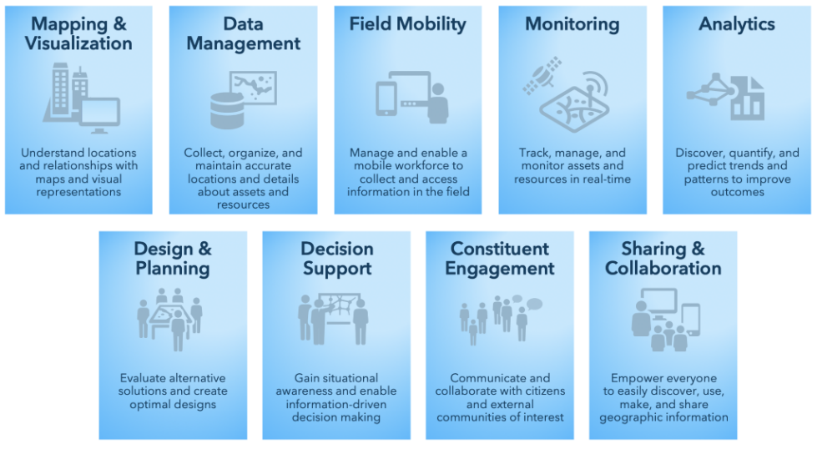
Patterns of Use for GIS
Notes:
When we talk with customers about the Roadmap and planning for future use, another tool we always use it the view of GIS patterns of use.
For any organization, comprehensive use of the technology can and should be accomplished in all patterns of use that align with the business of that organization. Noting current or as-is state along with priorities for the organization by considering each pattern of use is another way to look at resourcing and prioritizing use of GIS.
Based on our interviews with all of you and discussions with the core GIS team, we made these observations related to the Patterns of Use for GIS

Slide 10
EA Program Key Features
One License Fee
Four Year Term
Annual Payments
Uncapped Use for Core Software
Maintenance
Esri Enterprise Advantage Program
Notes:
[Internal: this slide is the high level overview (or teaser) – only go into as much detail as necessary]
To help organizations get the GIS technology and support they desire and to help achieve greater successes, Esri offers, to select customers, an Enterprise Agreement (EA) Program. This licensing program allows unlimited deployments of Esri ArcGIS software throughout the organization. Each EA proposal is customized to include the right set of products, training, etc. for your organization. In general, these represent the commonly used software solutions and options available from Esri. This provides organizations that depend on GIS technology unfettered access to spatial technology at the lowest cost per unit available. With this agreement, organizations won't have to pay for each seat of software. Instead they can deliver the power of GIS to employees throughout the enterprise as needed. The program provides access to Esri's latest software releases with a straightforward three year license fee. The GIS software becomes core IT infrastructure that supports all aspects of the business and not just individual desktop software solutions.
The EA program is designed to be easy to purchase from both a cost and contractual perspective. The EA is also designed to support our objective of integrating GIS with business critical systems. By removing barriers to software deployment these organizations will be able to realize the full value of GIS and integrate GIS in business areas that may not be possible without an EA.
License Model
Initial commitment is three years. Discuss how this is a fixed known payment that is spread over three years (three annual payments).
Fees cover software and maintenance. Challenges of outdated or un-maintained software are no longer a concern because the organization receives new, current releases of GIS software (for products covered by the EA) for the entire organization . Therefore all of your GIS software is made current (under the terms of the agreement). You no longer need to worry about software not on maintenance.
Many EA programs also include the Esri Enterprise Advantage Program (EEAP) which provides technical advisory services (planning and implementation). [Note: if you are not including this in the proposal, you may want to delete this line.]
Summary: organizations now have a way to deliver this valuable technology throughout the enterprise, which improves operational efficiency and service. Instead of concentrating resources on securing GIS software, an organization can rapidly access the GIS tools it requires to develop a robust GIS foundation and focus its energy on implementing departmental and discipline-specific solutions. This also eliminates the need to make tough decisions about whether it can incorporate new GIS technology such as GIS server-based software. Organizations that take advantage of this program will be able to improve GIS and IT consolidation initiatives, establish internal standards, and integrate Esri business partner solutions. Incorporating GIS into mission-critical applications and workflows will give staff throughout the enterprise the geographic advantage they need for better problem solving. Enterprise Agreements can foster the development and adoption of best practices.

Slide 11
State of Oregon – EA ArcGIS Licensing At-A-Glance
Desktop GIS
ArcGIS Desktop - All Levels
ArcGIS Pro – All Levels
ArcGIS Desktop/Pro Extensions
New Pro Extensions – ie Image Analyst
Online
GIS
ArcGIS Online Named Users (Creators, Viewers, Field Workers, Editors)
ArcGIS Hub Premium
ArcGIS Insights
Business Analyst Web
Drone2Map
Enterprise GIS
ArcGIS Enterprise - All Levels
Includes Enterprise Portal
ArcGIS Enterprise Extensions
ArcGIS Monitor
ArcGIS Insights
ArcGIS Developer Subscriptions
ArcGIS Indoors
Esri Redistricting
Other

Slide 12
Advantage Program
Maximizing ArcGIS Success with Esri Services & Support

Slide 13
Esri Services
Customer Enablement
Technical Support
Projects
Extensive resources and expert support
Delivering transformational capability
Premium Support
Esri Managed Services
Training
Business & Technical Consulting
Building workforce capabilities and capacity
Personalized and prioritized case management
Managing GIS in the cloud
Subject matter experts working with your team

Slide 14
Esri Services
Advantage Program
Vision, planning, advice and technical enablement
Customer Enablement
Technical Support
Projects
Extensive resources and expert support
Delivering transformational capability to customers through teaming
Premium Support
Esri Managed Services
Training
Business & Technical Consulting
Building workforce capabilities and capacity
Personalized and prioritized case management
Managing GIS in the cloud
Subject matter experts working with your team
Notes:
Access in a flexible way (flexible budget)
But also making sure we have context for what we’re doing and why
- Attach to vision for GIS within the org and org objectives,

Slide 15
More Information: Advantage Program Components & Learning & Service Credits
Technical Advisor
Annual Planning Session
Technical Work Plan
Learning & Services Credits
https://www.esri.com/en-us/landing-page/lp/eeap-component
State of Oregon Advantage Program annual term begins on July1,
each year for duration of current EA.
Annual Planning Session - Dates to be determined (Q1/2022)
Topics? (technology, workshops, training, ‘geostrategy’…)

Slide 16
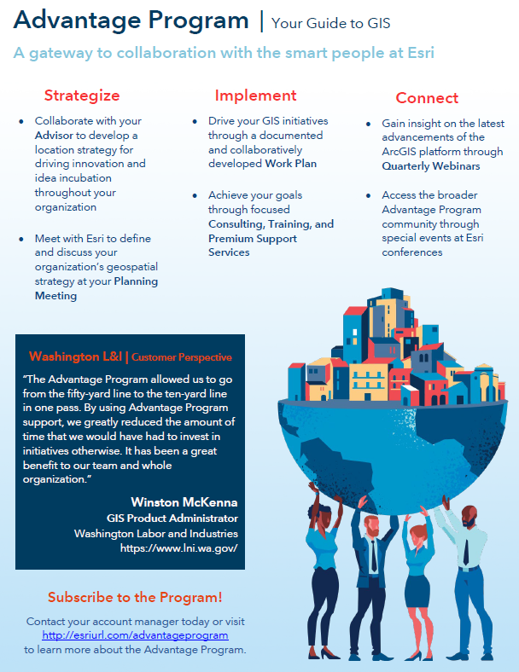
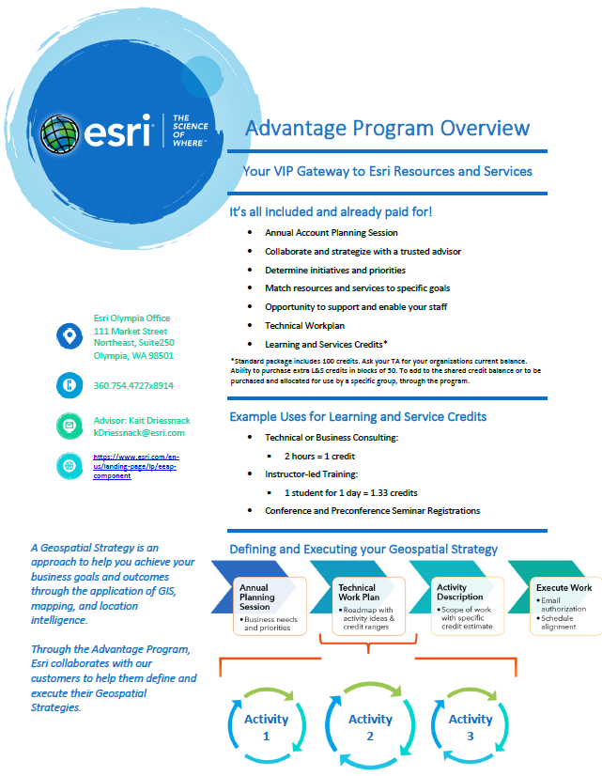

Slide 17
Resources
Enterprise Agreement
Contract on file at DAS GEO
Rachel Smith, GIO/Deputy CDO
Web page: https://www.esri.com/en-us/industries/enterprise-agreement/overview
Advantage Program
Web page: https://www.esri.com/en-us/industries/enterprise-agreement/overview

Slide 18
Your Esri Team Call on us anytime!
Terri Morganson
Senior Account Manager
tmorganson@esri.com
909-369-8905
Chris Marsh
Senior Solution Engineer
c.marsh@esri.com
360-754-4727 x.8909
Plus:
Training Consultant – Tabetha Perrault
AP Advisor – Kait Dreissnack
Customer Service Representative – Kelly Angerer
Industry & Product Domain Expertise - as needed
Notes:
Comment on how we can help them get from ideas & questions into a path forward. We can help them articulate task request to our partners who are on the GIS term contracts. We can help them articulate needs from the GIS team and/or help them directly ramp up on accessible tools – like story maps……

Slide 19
Copyright © 2021 Esri. All rights reserved.
Notes:
UC 2021 Walk-Out (Animated)

