Slide 1
Matt Williams, FIT Co-lead
December 18, 2024
Oregon Framework
16 themes that form the foundation for an authoritative seamless statewide GIS

Slide 2
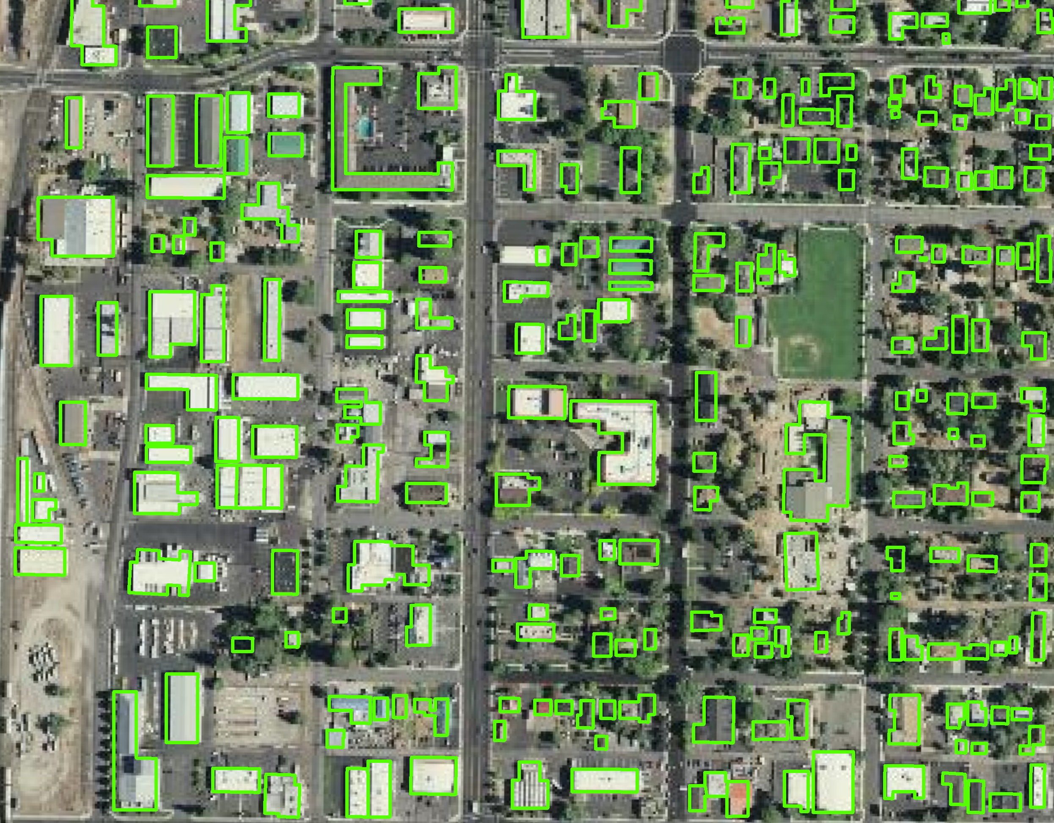
Presentation Overview
Attribute breakdown
Review of out-of-state building attributes
Review of in-state building attributes
SBFO attributes
Notes:
You can be involved in one, the other, or both

Slide 3
Building Footprints Standards - Priorities
Compare existing building datasets from around US (no current Data Standard)
Identify needs from other Framework Themes that could be met by buildings
Identify needs from county and city partners around Oregon
Identify the priorities for the building elements
  Core Most important or mandatory minimum fields, must be supplied
  Important Recommended, can be derived from core
  Useful Optional or nice to have, can be derived from core or location
  Not important nor relevant
Add any other necessary fields

Slide 4
Identified Problems
No Data Standard
More useful attributes (e.g., occupancy type)
Frequent maintenance necessary to keep up with new development
Availability of new imagery to verify buildings
Connecting to related datasets
Maintaining persistent building IDs through an update

Slide 5
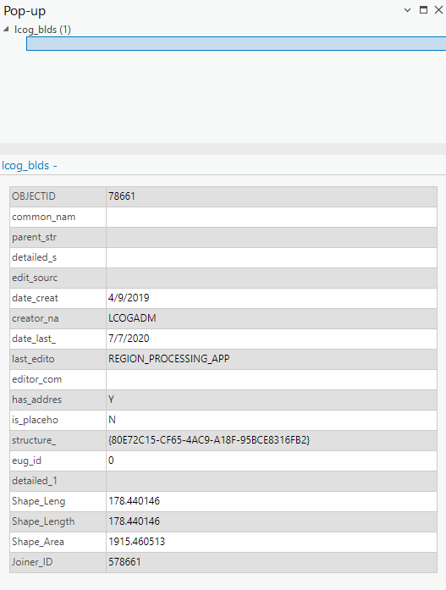
Attribute categories
Identifiers/Indexing/Keys
  Unique ID
  Address ID
Descriptive
  Occupancy Type
  Number of stories
Location
  Lat/Long
  Flood zone
Metadata
  Source imagery
  Last edited
Notes:
FGDC current OGIC-endorsed standard (2014)
Numbered Thoroughfare class
FGDC, NENA, NAD
Less familiar
similar in the way they -
Parse street number
Parse street name
Separate city categories
USPS
More familiar
Single street number field
Single street name field
Single city field
OPTIONS
Keep FGDC
Choose another standard
Choose another standard with modified or added fields
Choose none – Completely custom
Combine standards
Combine standards with modified or added fields

Slide 6
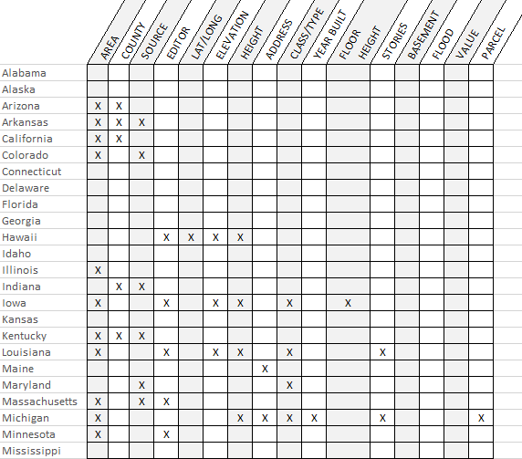

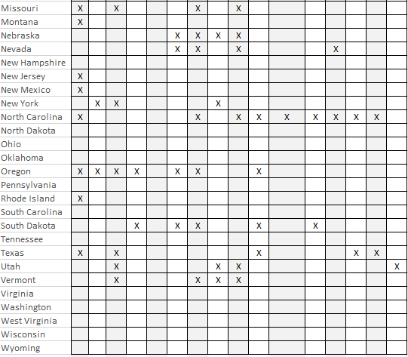
Attributes included in U.S. building datasets
Notes:
Complete
All Numbered Thoroughfare address points in Oregon
Including all unit numbers
Houses, apartments, mobile homes, accessory dwelling units, condominiums
Commercial, government
Offices, retail, manufacturing, farm
Schools, public facilities.
Residential, non-residential, group quarters
NOT
Residential addressees, tenants, no personal information
Landmarks, points of interest, mileposts, intersections
Infrastructure, machinery only

Slide 7
Various Building Footprint Attributes
Area (not the default geodatabase area)
County name
Source (data type, date of source, digitization method, contributor)
Editor (date of edits, who edited, validation imagery, imagery date)
Lat/Long
Elevation (lowest adjacent grade, centroid elevation)
Height (roof height - min, max, avg)
Address
Class/Type (e.g., residential, commercial, public, etc.)
Year Built
First Floor Height (typically used for flood risk analysis)
Stories
Basement
Flood (flood exposure)
Value
Parcel

Slide 8
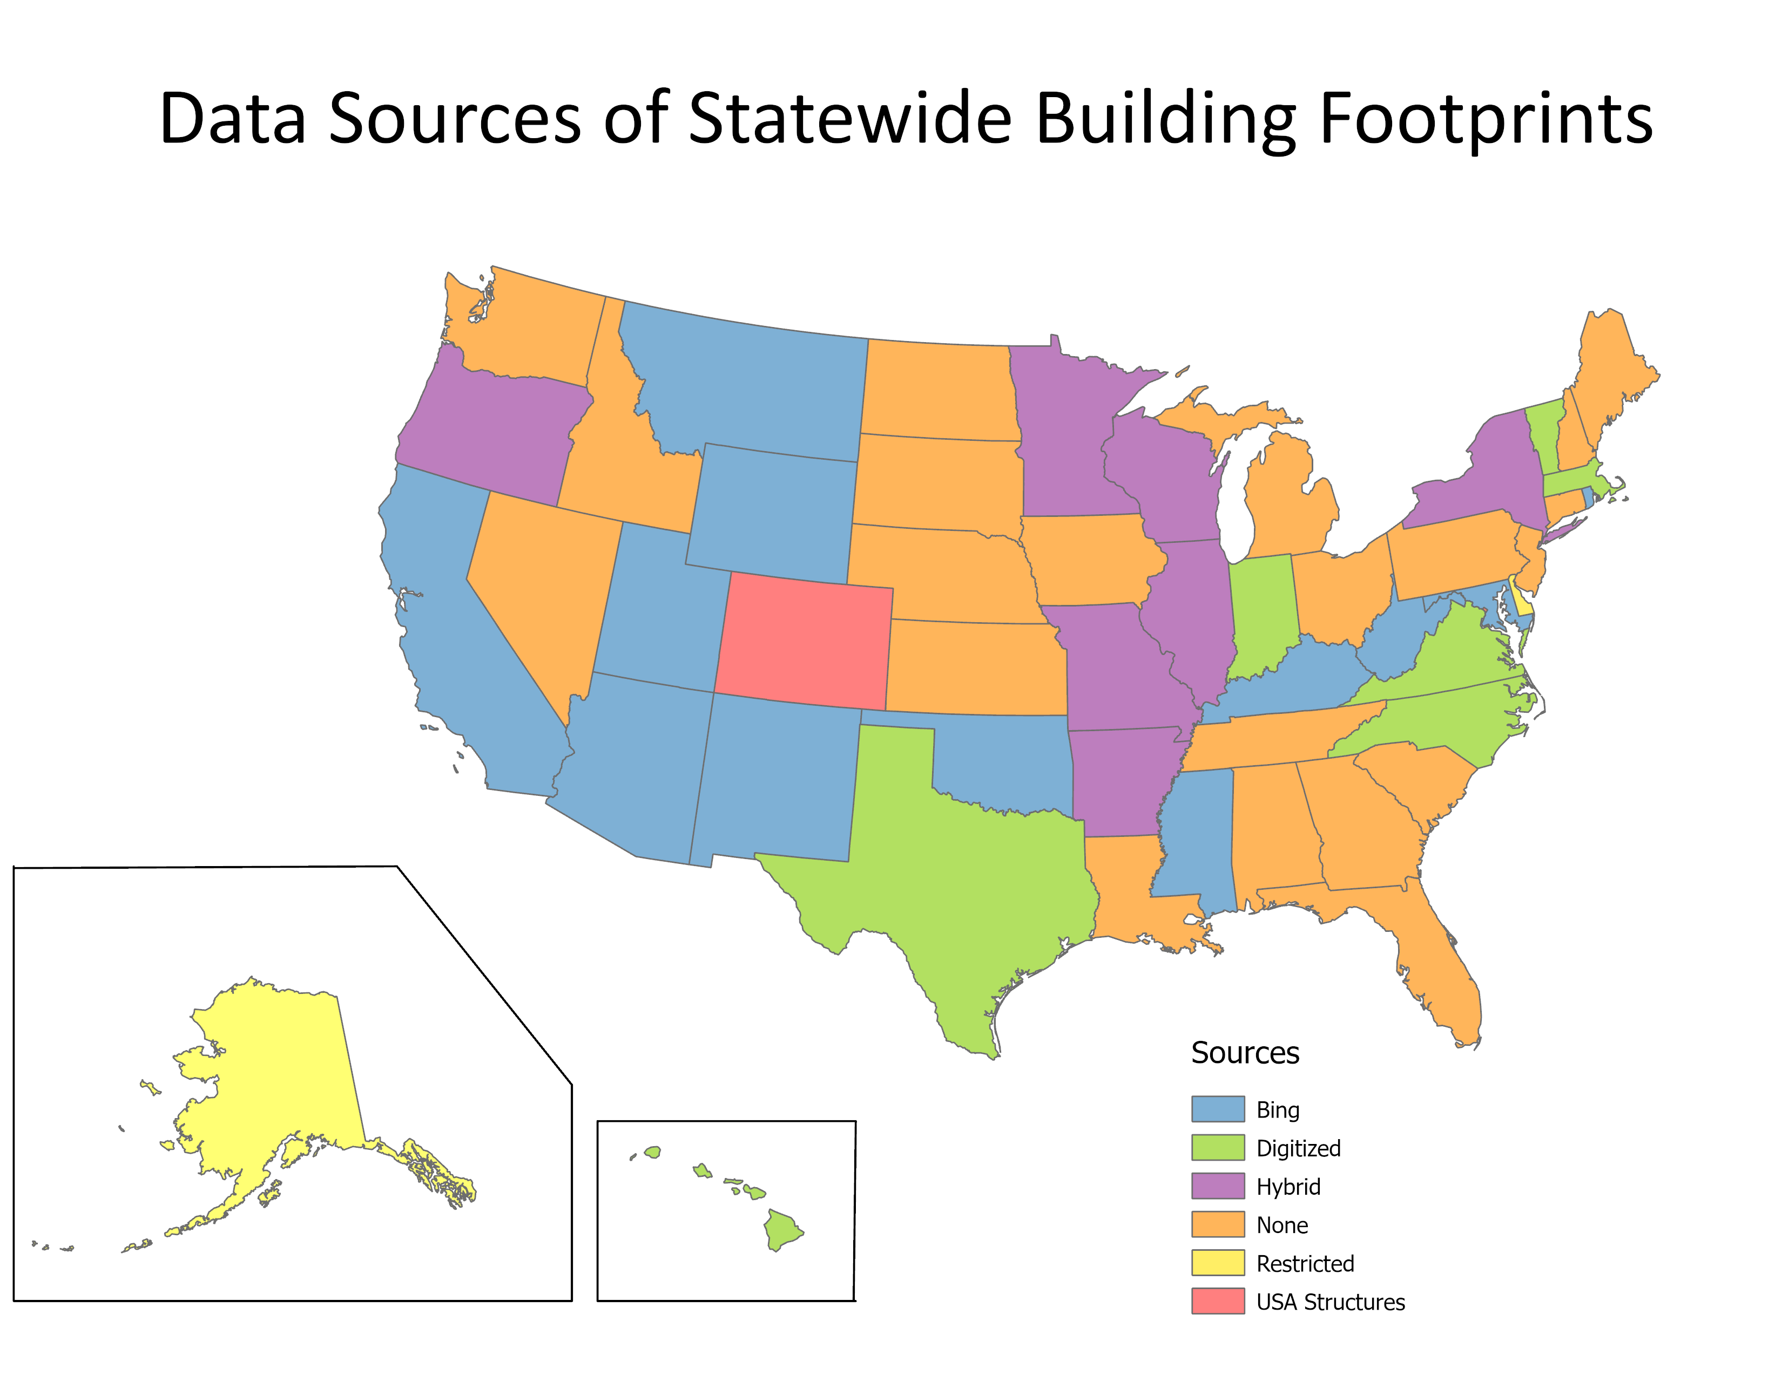
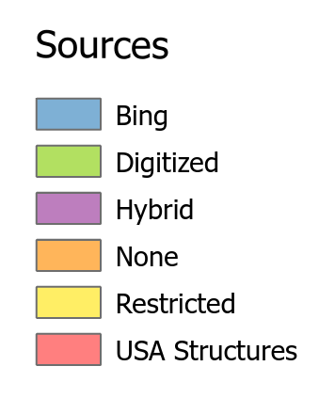
Statewide Data Sources
Most states, including Oregon, are using Bing buildings as a source of building data
Notes:
Complete
All Numbered Thoroughfare address points in Oregon
Including all unit numbers
Houses, apartments, mobile homes, accessory dwelling units, condominiums
Commercial, government
Offices, retail, manufacturing, farm
Schools, public facilities.
Residential, non-residential, group quarters
NOT
Residential addressees, tenants, no personal information
Landmarks, points of interest, mileposts, intersections
Infrastructure, machinery only

Slide 9
Building footprint data examples
North Carolina
Illinois
California State Parks
Des Moines, Iowa
Southeast Michigan Council of Governments (Detroit)
New York City Open Data
Notes:
You can be involved in one, the other, or both

Slide 10
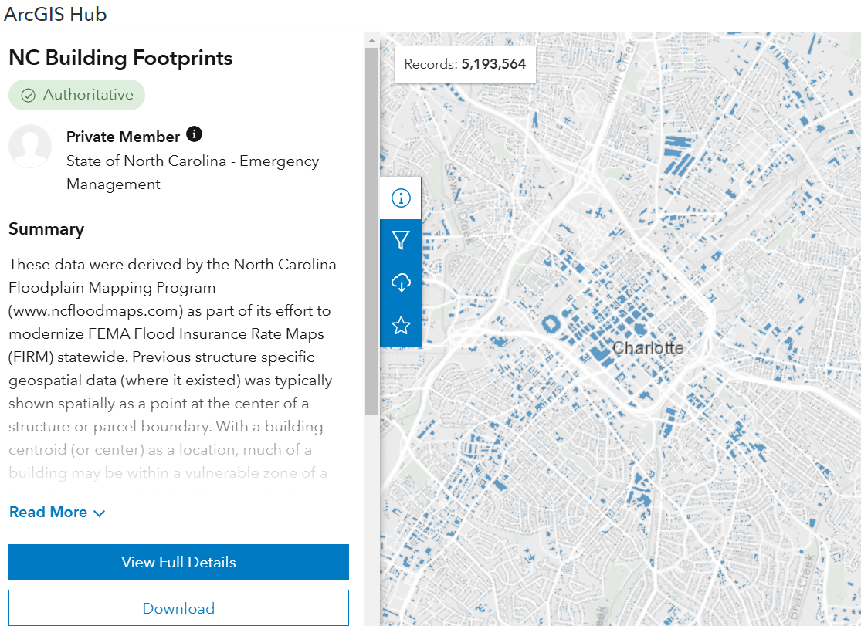
North Carolina attributes
BLDG_ID
OCCUP_TYPE
BUILD_TYPE
FL_SCHEME
FLD_ZONE
STATIC_BFE
WIND_ZONE
YEAR_BUILT
YRBUILTSRC
BLDG_VALUE
BLDGADJFAC
BLDGREPVAL
CONTREPVAL
INVREPVAL
HTD_SQ_FT
HTDSQFTSRC
FFE
FFE_TYP
LIDAR_LAG
LIDAR_HAG
FOUND_TYPE
BASEMENT_TY
NUM_STORY
NUM_UNITS
ISCOASTAL
ISLIMWA
Notes:
You can be involved in one, the other, or both

Slide 11
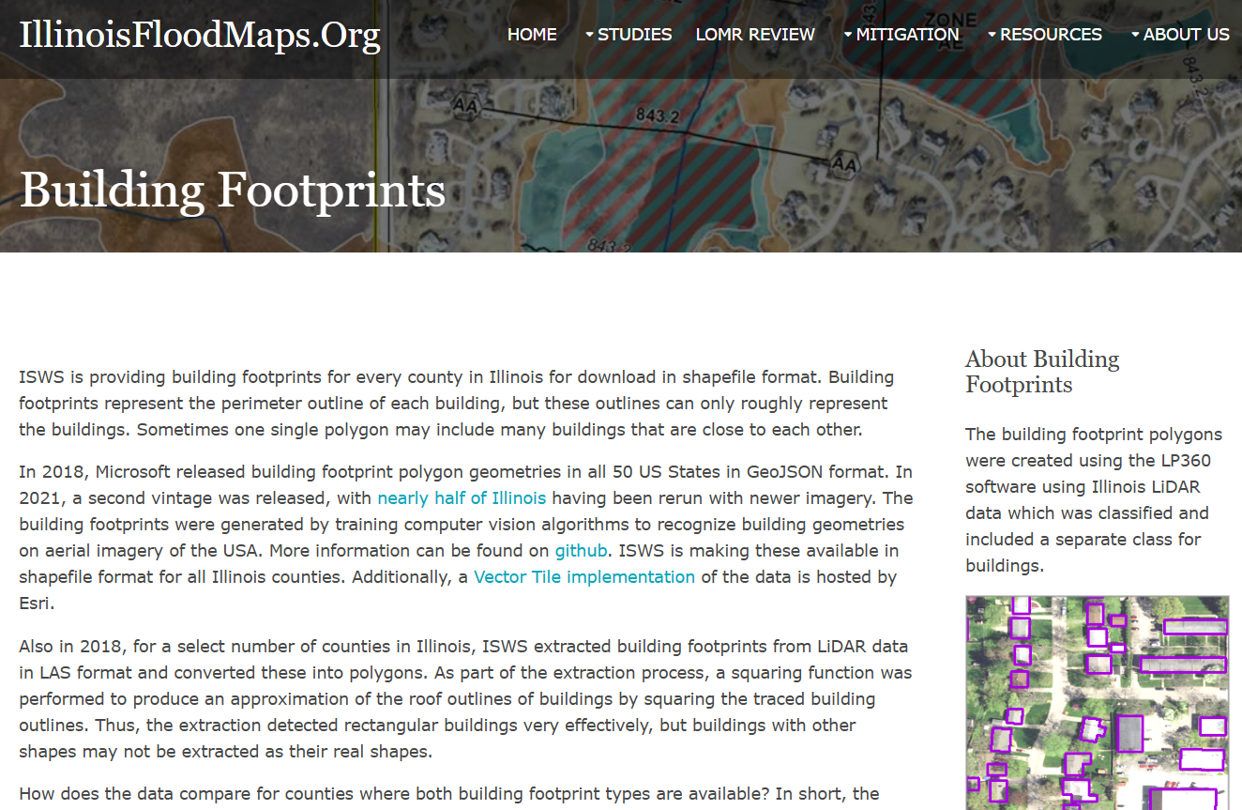
Illinois attributes
ID
Area
RmsErr
MaxErr
ForceFit
Notes:
You can be involved in one, the other, or both

Slide 12
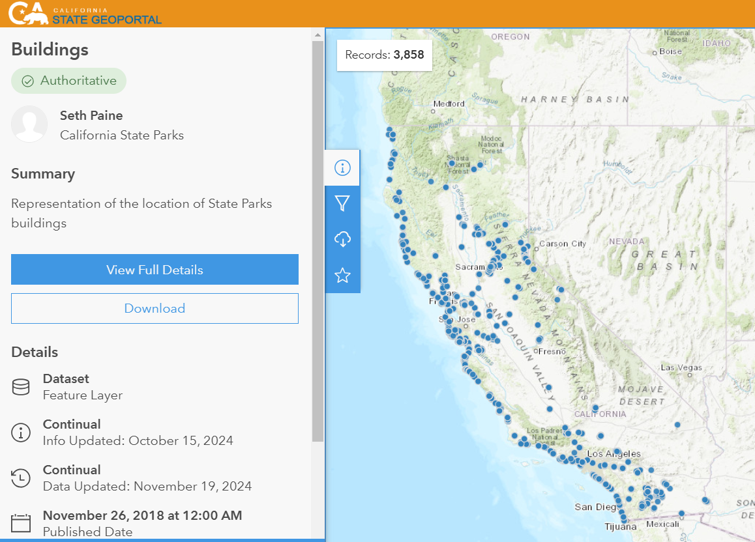
California State Park building attributes
GISID
DETAIL (Building name)
TYPE
SUBCLASS (e.g. Public Use)
UNITNBR (Unit number)
UNITNAME (St. Park Name)
SHARE
Notes:
You can be involved in one, the other, or both

Slide 13
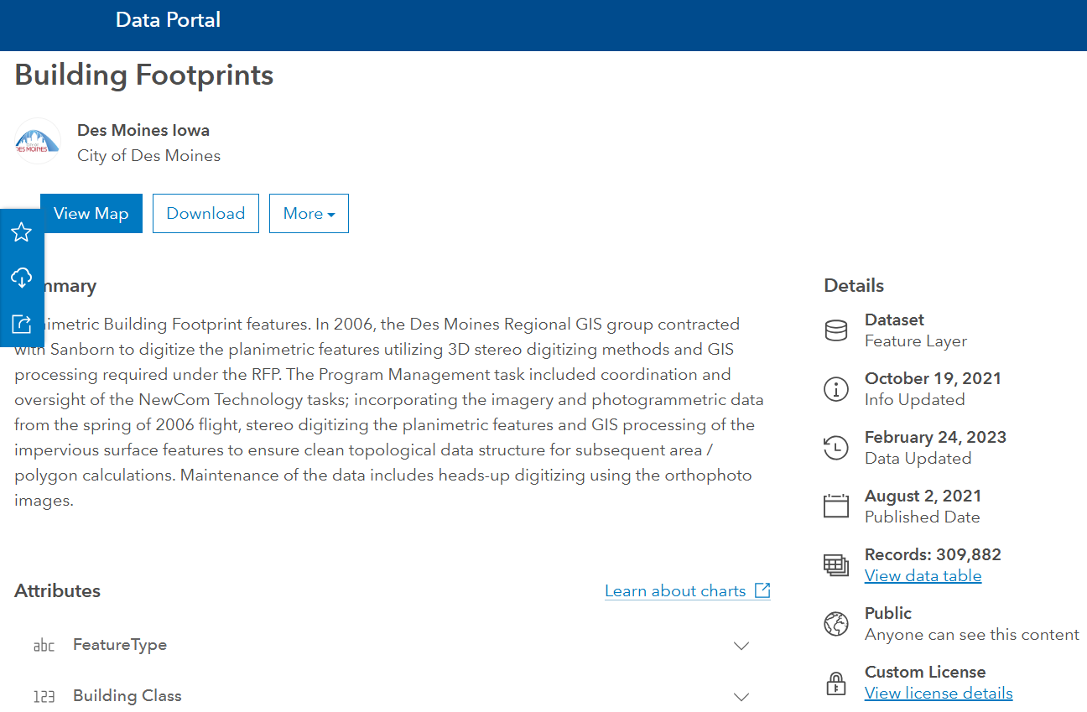
Des Moines, Iowa buildings attributes
FeatureType
Building Class
NbrFloors
BuildingHeightFt
BaseElevFt
City
Last_edited_date
Last_edited_user
Created_date
Created_user
Notes:
You can be involved in one, the other, or both

Slide 14
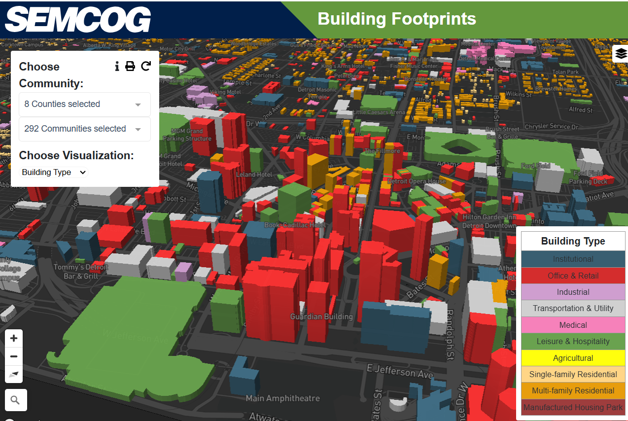
SEMCOG buildings attributes
BUILDING_ID
PARCEL_ID
BUILD_TYPE
CITY_ID
APN (Assessor Parcel Num)
RES_SQFT
NONRES_SQFT
YEAR_BUILT
DEMOLISHED
HOUSING_UNITS
STORIES
LOADD1
HIADD1
STREET1
LOADD2
HIADD2
STREET2
ZIPCODE
AKA
USE_LOCATOR (flagged as an address locator)
GQCAP (Group quarter cap)
SOURCE
Notes:
You can be involved in one, the other, or both

Slide 15
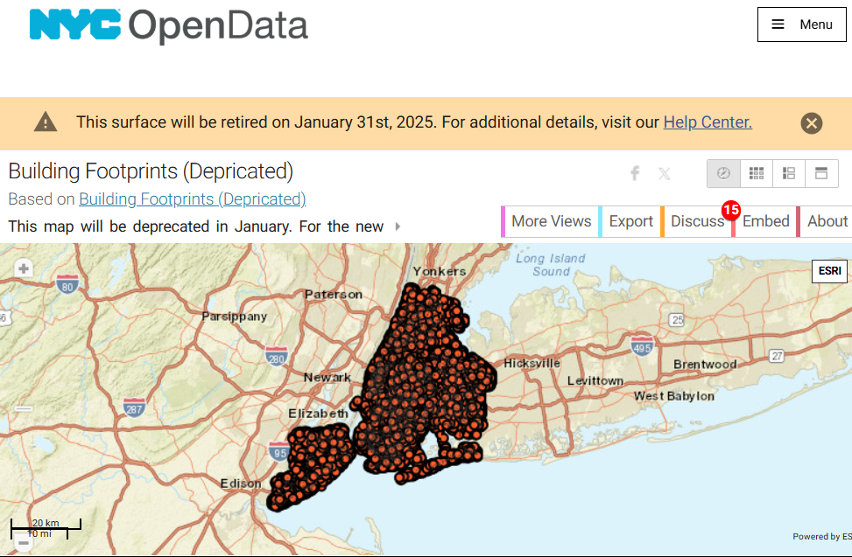
New York City buildings attributes
Address Range
Address Point Count
Most Common Street
Other Streets
County name
Municipality Name
NYSGeo Source
Source
Source Date
Source ID
Notes:
You can be involved in one, the other, or both

Slide 16
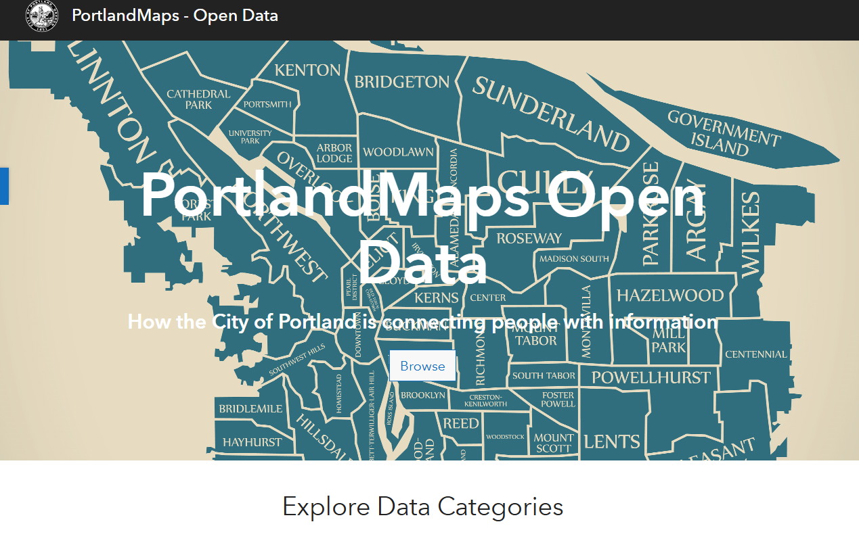
Portland buildings attributes
Bldg ID
State ID
Bldg Num
BldgStatus
Bldg Name
Address
Type
Use
Square Ft
Sqft Src
Stories
Story Src
Units res
Unit Src
Capacity
Capac Src
ADA Access
Year Built
StrucType
StructCond
Source
Source Ref
Avg Height
Max Height
Height Src
Surf Elev
Surf Off
Surf Adj
Surf Src
Roof Elev
Roof Type
Orient
Volume
PROPKEY
DATA_SOURCE
Notes:
You can be involved in one, the other, or both

Slide 17
LCOG buildings attributes
x_max
y_max
source_name
source_type
year_source_collected
review_imagery_name
year_review_imagery_collected
date_reviewed
structure_alt_key
structure_geo_id
eug_id
GlobalID
date_last_updated
common_name
is_demolished
detailed_structure_type_code
detailed_structure_type_name
general_structure_type_code
general_structure_type_name
general_structure_use_code
general_structure_use_name
structure_use_class
is_city_landmark
city_landmark_name
historic_register_number
historic_register_name
address_count
reference_maptaxlot
property_alt_key
school_district_code
parent_structure_geo_id
flood_hazard_area_id
flood_insurance_rate_map_number
census_block_fips_code
enterprise_zone_code
market_area_name
urban_growth_boundary_code
urban_reserve_code
full_city_annexation
has_fire_protection
is_placeholder
area_sqft
perimeter_ft
longitude_center
latitude_center
x_center
y_center
x_min
y_min
Notes:
You can be involved in one, the other, or both

Slide 18
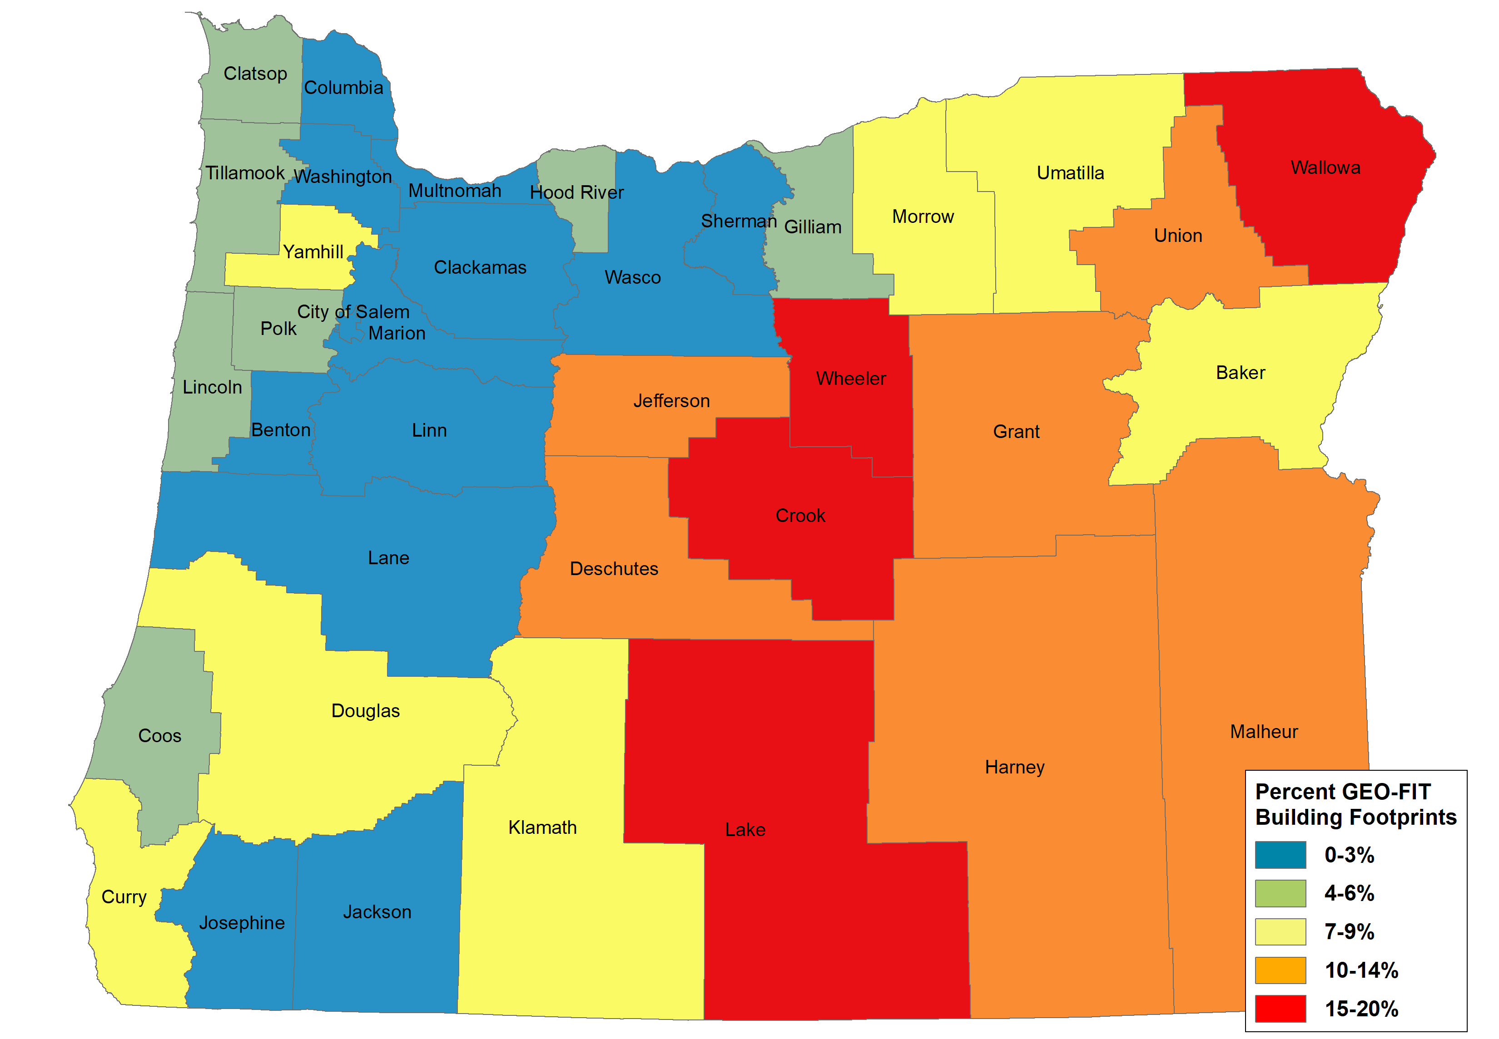
SBFO attributes
ORBLD_ID
COUNTY
CONTRIBUTOR
SOURCE
SOURCE_TYPE
SOURCE_DATE
LAG
ROOF_MEAN
ROOF_MAX
YEAR_BUILT
SQ_FT
REVIEW_IMG
REVIEW_IMG_YEAR
REVIEW_DATE
Notes:
You can be involved in one, the other, or both

Slide 19
Proposed attributes for SBFO Data Standard
Please review and comment on spreadsheet (email attachment)
Yea or nay on attributes
Please include additional suggested attributes not listed
  Be sure to describe the attribute in the notes column
We will take a closer look at these attributes at the next workgroup meeting
Notes:
You can be involved in one, the other, or both

Slide 20
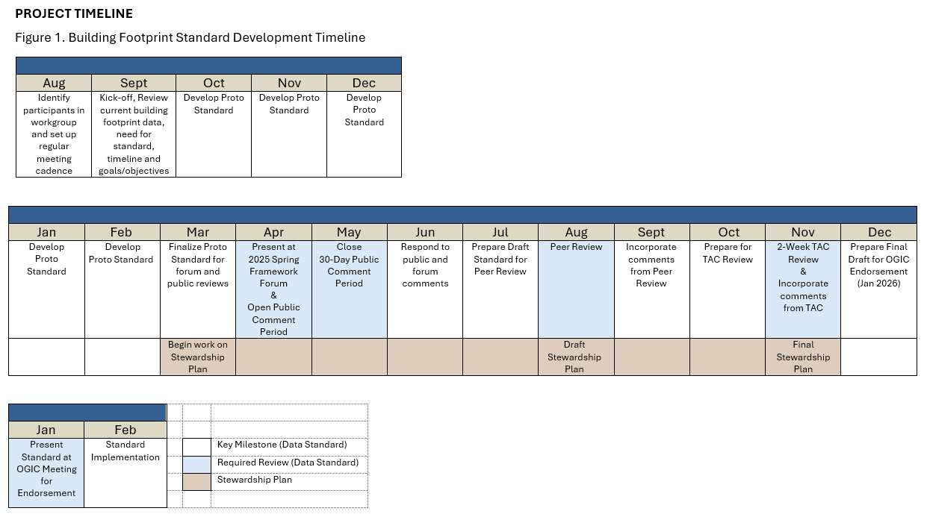
Possible Future Updates

Slide 21
Thank You!
Tom.Elder@das.oregon.gov
Matt.Williams@dgmi.oregon.gov

