Slide 1
Matt Williams, FIT Co-lead
December 18, 2024
Oregon Framework
16 themes that form the foundation for an authoritative seamless statewide GIS

Slide 2
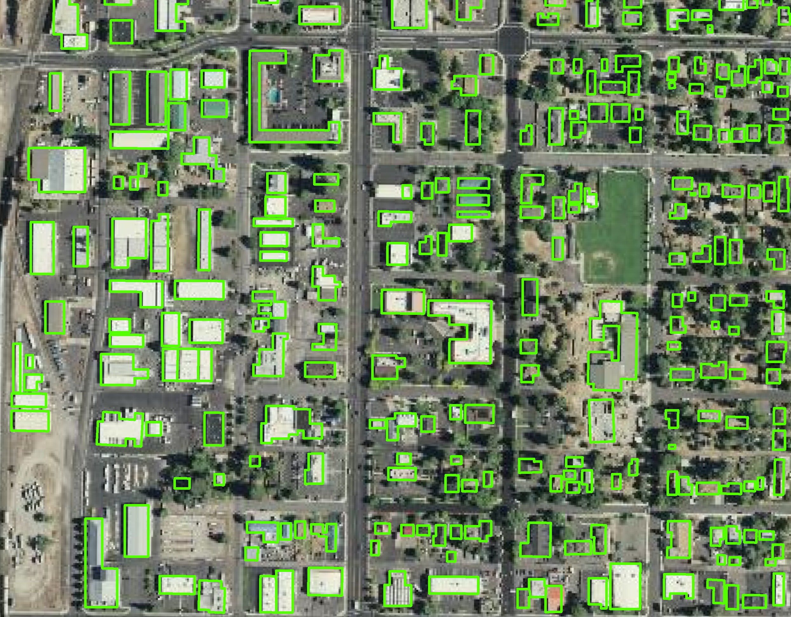
Presentation Overview
Attribute categories
  Structure
  Address
  Parcel
  Metadata
Review of proposed attributes
Consensus building discussion

Slide 3
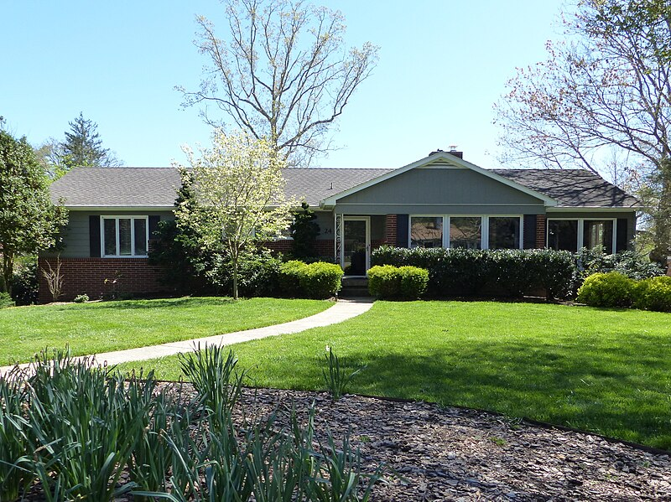
Attributes: STRUCTURE
ORBLD_ID
SQ_FT (Calculated from footprint, not the same as living area)
Latitude & Longitude (Decimal degree format)
Flood_zone (yes or no) *
Float_struc (yes or no)
LAG (lowest adjacent grade or minimum elevation)
ROOF_MAX *
ROOF_MEAN
Roof_Type (roof construction) *
URM (Unreinforced masonry) *
COUNTY *
Zipcode *

Slide 4
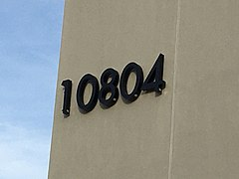
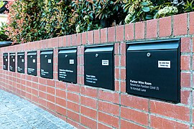

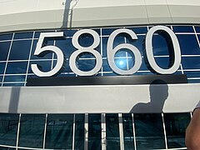
Attributes: ADDRESS
Address_ID
Address
Num_Units (redundant with Housing Units?)
Bld_Name *
Historic (yes or no)

Slide 5
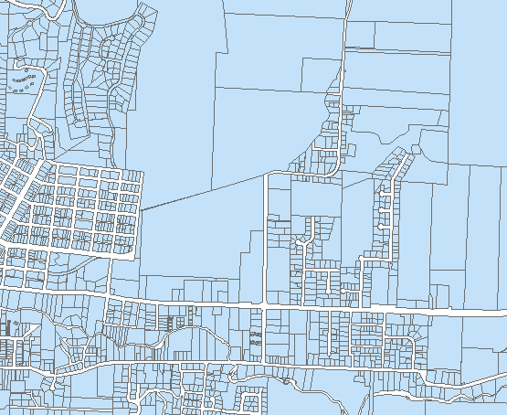
Attributes: PARCEL
Parcel_ID
Parcel_Num
Basement (yes or no)
Housing_Unit * (redundant with Number of Units?)
Num_Stories
YEAR_BUILT
Year_Src *
First_Flr_Ht
Bld_Type
Found_Type
Occ_Type
ReplacementCost*
RMV *
RMV_Src *

Slide 6
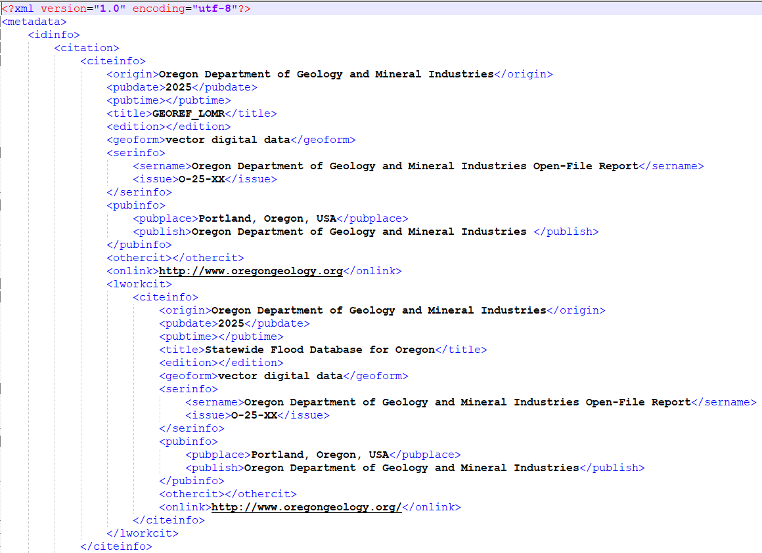
Attributes: METADATA
PUB_DATE
REVIEW_DATE
REVIEW_IMG
REVIEW_IMG_YEAR
BLD_SRC (currently “SOURCE”)
BLD_SRC_DATE (currently “SOURCE_DATE”)
BLD_SRC_TYPE (currently “SOURCE_TYPE”)
CONTRIBUTOR
Editor *

Slide 7
Review: STRUCTURE
Latitude & Longitude*
Flood_zone *
Float_struc
LAG
ROOF_MAX *
ROOF_MEAN
Roof_Type *
URM *
COUNTY *
Zipcode *

Slide 8
Review: ADDRESS
Address_ID
Address
Num_Units (Housing Units) *
Bld_Name *
Historic

Slide 9
Review: PARCEL
Parcel_ID
Parcel_Num
Basement
Housing_Unit *
Num_Stories
YEAR_BUILT
Year_Src
First_Flr_Ht
Bld_Type
Found_Type
Occ_Type
RMV *
RMV_Src *

Slide 10
Review: METADATA
PUB_DATE
REVIEW_DATE
REVIEW_IMG
REVIEW_IMG_YEAR
BLD_SRC
BLD_SRC_DATE
BLD_SRC_TYPE
CONTRIBUTOR
Editor *

Slide 11

Next steps
Consensus attributes
Attribute format discussion
“Proto Data Standard”
Identify any lingering issues
Image source: Wikimedia commons, Jamidwyer, 11/9/2006

Slide 12
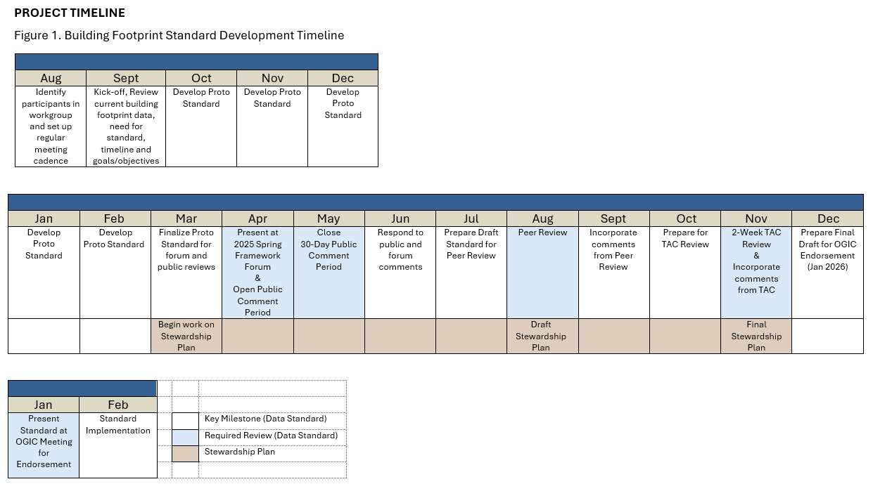
Possible Future Updates

Slide 13
Thank You!
Tom.Elder@das.oregon.gov
Matt.Williams@dgmi.oregon.gov

