Slide 1
Tom Elder, FIT Co-Lead
Matt Williams, FIT Co-Lead
October 29, 2024
Oregon Framework
16 themes that form the foundation for an authoritative seamless statewide GIS

Slide 2
Addresses and Buildings Framework Implementation Team
Present progress on the Address Point Standard so far
Present next steps for wider review leading to OGIC approval
Preview of important address point projects coming soon

Slide 3
Starting Point
Completely new FIT theme
  Combination of Address Points and Building Footprints
First time for everyone
  Team Lead
  Framework Coordinator
Four national address standards already available

Slide 4
Schedule
May 22 – Addresses & Buildings Framework FIT kickoff
June 18 - First Workgroup Meeting - Kickoff
July 16 – Second Workgroup Meeting – Standards Comparison
August 20 – Third Workgroup Meeting – NENA deep dive
September 17 - Forth Workgroup Meeting – Draft standard
October 15 - Fifth Workgroup Meeting – Revise draft standard
October 29 - Fall Framework Forum – Present draft standard
November - Building Footprint Standard kickoff
Spring 2025 - Present Address Point Standard to OGIC
Notes:
Workgroup met monthly five times over the summer and fall. Kept meetings to one hour.

Slide 5
FIT Volunteers – Workgroup Participants in bold
Alex Petzold | Oregon Department of Emergency Management
Alicia Wood | Oregon Metro
Anthony Testi | Oregon Secretary of State
Ariel Low | Oregon Legislative Policy and Research Office
Bethy Rogers-Pachico | Confederated Tribes of the Umatilla Indian Reservation
Brent Cecil | Oregon Secretary of State
Brian Shepard | City of Astoria
Chrissy Barrows | Lane Council of Governments
Daniel Stoelb | Oregon Department of Emergency Management
Erik Larsen | Oregon Department of Forestry
Ethan Sharygin | Portland State University Population Research Center
Franz Arend | Oregon Metro
Hilary Leavell | City of Salem
Ish Padin-Dujon | Oregon Department of Human Services
Janette Cook | City of Portland Bureau of Development Services
Jason Ford | US Department of Transportation/NAD
Jason Yaich | City of Corvallis
Notes:
Great participation! – 34 volunteers, 17 attended at least one of the workgroup meetings (bold).

Slide 6
FIT Volunteers - Continued
Jessica Beierman | Geocomm
Juliana Wold | Oregon Department of Emergency Management
Kristi Culver | City of Corvallis Development Services Division
Kurt Abe | City of Portland Bureau of Development Services
Matt Williams | Oregon Department of Geology and Mineral Industries
Melanie Wadsworth | Business Oregon
Melissa Foltz | Oregon Department of Administrative Services
Paul Cone | City of Portland
Paul Platosh | Enterprise Asset Management
Rachel Smith | Oregon Department of Administrative Services
Randy Dana | Oregon Department of Land Conservation and Development
Sarah Marvin | Oregon Department of Land Conservation and Development
Tim Esau | Oregon Secretary of State
Tim Smothers | Baker County & City Planning Department
Tim VanDeWalle | Yamhill Communications
Tom Elder | Oregon Department of Administrative Services
Willow Crum | Oregon Department of Administrative Services

Slide 7
Overall Goals for the Address Data Standard
Make sure it works for Oregon addresses
Make it complete so it works for most people
Make it clear and easy to use the standard
Make it flexible for multiple purposes and products
Make it sustainable to keep it current and relevant
Make it scalable from the local to national level
Make it public
Notes:
A complex standard will not be used.

Slide 8
Multiple Uses
Table 2- Identified use cases for the Oregon Address Point Data Standard.
Category | Use-Case
Census | Redistricting Voter Registration Elections
Public Safety | Next Generation 9-1-1 Dispatchable Locations
Emergency Management | Risk Assessment Event Notification Evacuation
Disaster Response | Damage Assessment Search and Rescue
Property | Building Permitting Tax Assessment
Utilities | Broadband Mail
Service Delivery | Application Verification and Qualification Billing Record Keeping and Compliance
Planning and Development | Transportation Housing Public Health Business and Economic Development

Slide 9
Four Major National Address Standards
FGDC Federal Geographic Data Committee
NENA National Emergency Number Association
NAD National Address Database
USPS US Postal Service
Links for each standard are on the GEOHub Addresses and Buildings Framework page.
FGDC, NENA, NAD
Are related and have a similar format
Notes:
FGDC current OGIC-endorsed standard (2014)
Numbered Thoroughfare class
FGDC, NENA, NAD
Less familiar
similar in the way they -
Parse street number
Parse street name
Separate city categories
USPS
More familiar
Single street number field
Single street name field
Single city field
OPTIONS
Keep FGDC
Choose another standard
Choose another standard with modified or added fields
Choose none – Completely custom
Combine standards
Combine standards with modified or added fields

Slide 10
Draft Oregon Standard Proposal
DRAFT - Review, discussion, revision cycle
Similar to Idaho’s standard
NENA Core
Changed field requirements
  Unit
Added supplemental fields
  Broader use cases
  Open-ended

Slide 11
Starting Point – NENA Core
NENA is similar and closely related to both the FGDC and NAD standards.
NENA is much simpler than FGDC and easier to implement.
Many other states already use NENA.
    Idaho’s example standard
Most address point data is already available from PSAPs in NENA format.
Work in cooperation with the ongoing NG911 Technical Advisory Committee.
NENA could accommodate other business requirements with supplemental fields.

Slide 12
Draft Standard Highlights
Addresses must be Complete, Consistent, Unique
  Changes Units to Conditionally Required (from not required)
Focus on Street Addresses - Physical Locations
All Types - Residential, Non-Residential, Group Quarters
Related to Parcel and Building Footprint Standards

Slide 13
Comments
Over 76 comments received in the Teams Channel.
More comments received in email.
Majority of comments were for clarification.
A few comments were for content.
There are still a few headings that need to be filled in.

Slide 14
Address Point Standard - Next Steps
New version (0.2) incorporates all comments received so far.
Add missing headings. Add domains and lookup tables.
Review again for compatibility with other Framework standards.
  Use Framework Standard template
Review continues by other groups and the GIS community. New versions (0.3, 0.4…) late 2024 – early 2025
Present to OGIC for approval in the Spring 2025
Will be used to support large future address projects…
Notes:
Future payoff

Slide 15
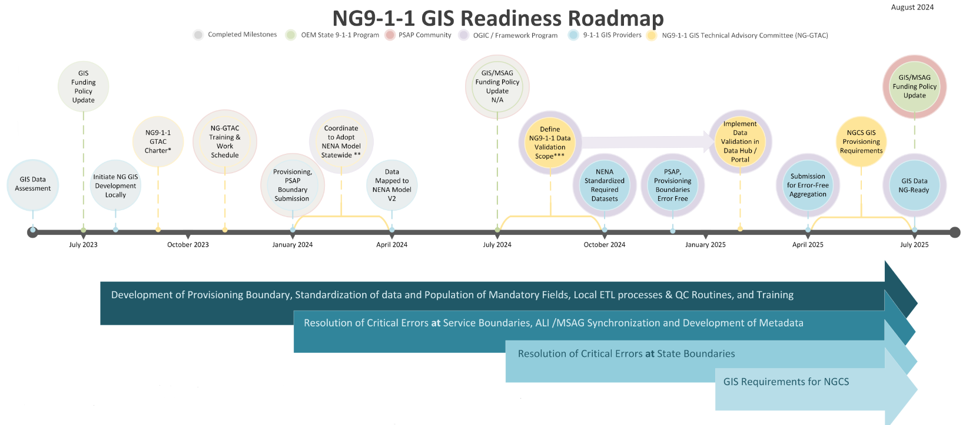
Next Generation 9-1-1
https://or-ng911-geo.hub.arcgis.com
Notes:
Many participants are from the NGTAC.

Slide 16
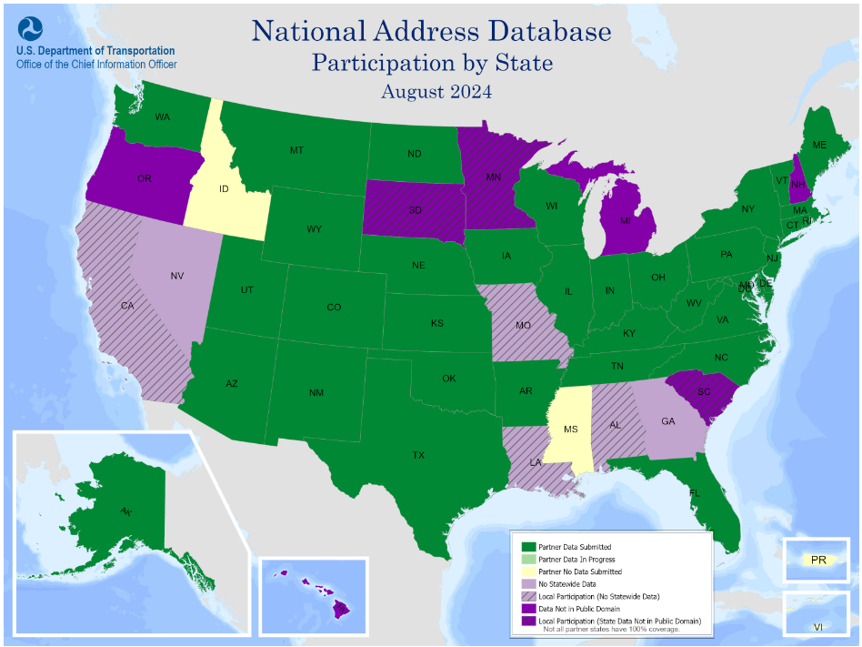
National Address Database
https://www.transportation.gov/gis/
national-address-database
Local
↕
State
↕
National

Slide 17
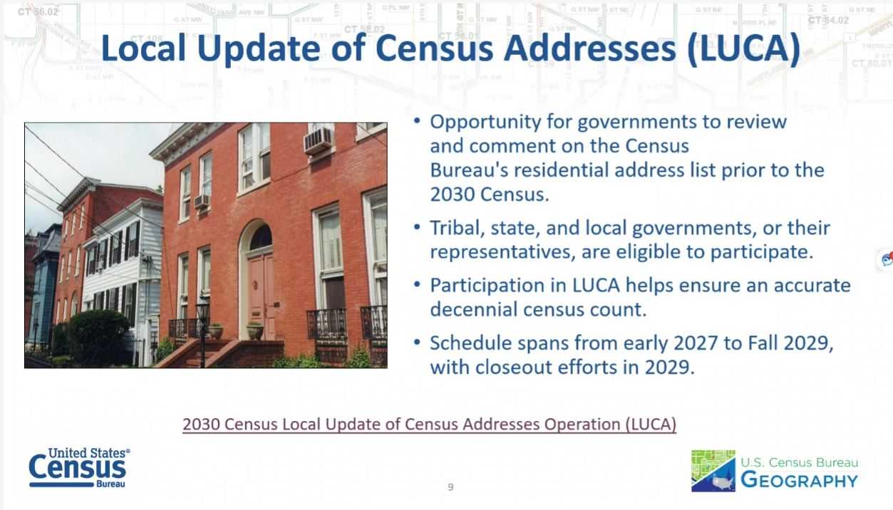
Census 2030 LUCA
https://www.census.gov/programs-surveys/decennial-census/decade/
2030/planning-management/where/2030-census-luca.html

Slide 18
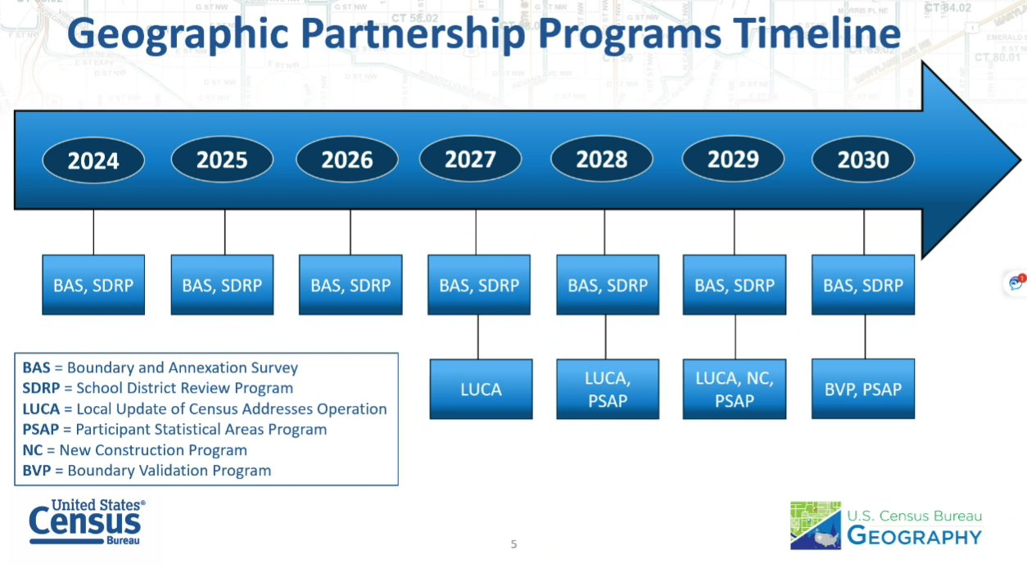
Census 2030 Timeline

Slide 19
Thank You!
Tom.Elder@das.oregon.gov
Matt.Williams@dogami.oregon.gov
Notes:
New building footprint standard workgroup starting up.

