Slide 1
Moving Idaho Towards Next Generation 911
Integrity | • | Teamwork | • | Service

Slide 2
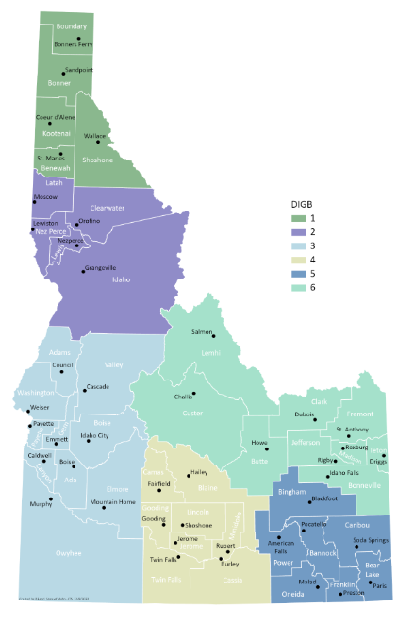
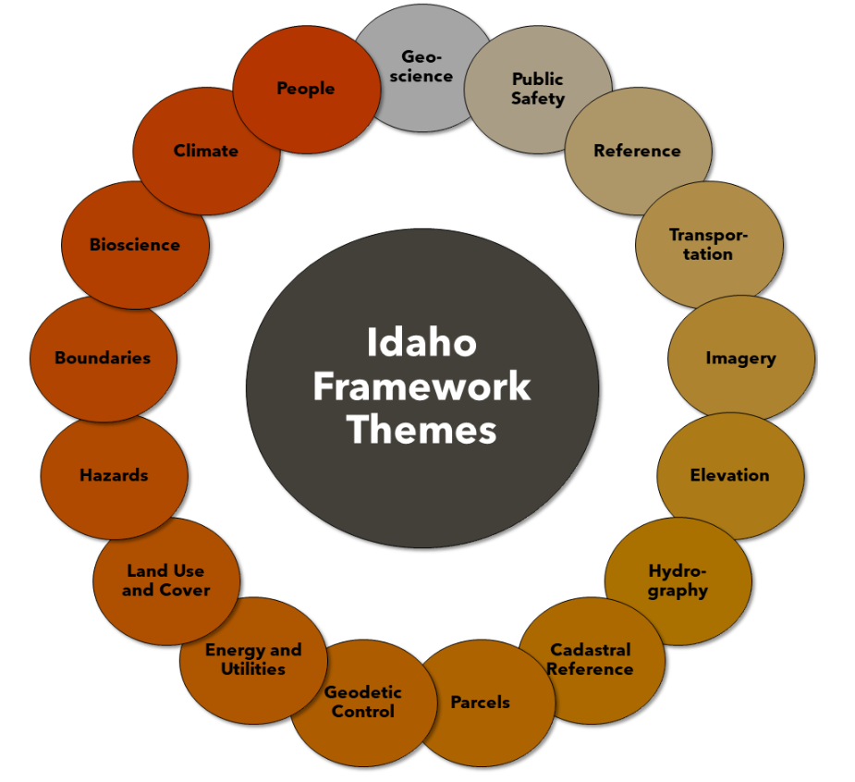
Idaho NG 9-1-1
Idaho Legislature allocated funds to IOEM
Idaho Geospatial Office in the Office of Information Technology Services nominated NG 911 Data Standards
Idaho Geospatial Counsel – Executive Committee adopted NG 911 Data Standards
Geographic Information Officer appointed
Integrity | • | Teamwork | • | Service
Notes:
Idaho Legislature allocated 1.3 million to IOEM to fund Next Generation GIS project in 2022.
Contractors hired around September of that year.
Public Safety Technical Working Group in the Idaho Geospatial office nominated the Idaho NG 911 standard which is based on the NENA standard, with additional fields for Idaho
IGC-EC adopts the Idaho Standard for Next Generation 911
Wilma Robertson named State Geographic Information Officer

Slide 3
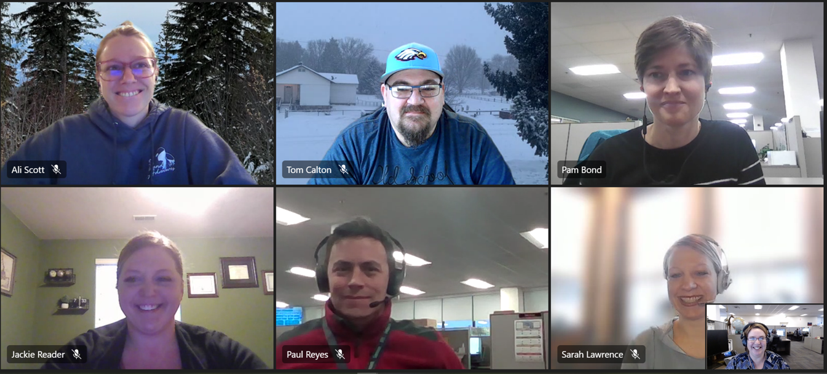
GIS Team
NG9-1-1 GIS Readiness Project Lead
Wilma Robertson, wilma.robertson@its.idaho.gov
Geographic Information Officer (GIO)
Regional GIS Contractors
Ali Scott, DIGB 1 and 2 (Northern Idaho), ali.scott@its.idaho.gov
Paul Reyes, DIGB 3 and 4 (Western Idaho), paul.reyes@its.idaho.gov
Tom Calton, DIGB 4, 5 and 6 (Eastern Idaho), tom.calton@its.idaho.gov
Pam Bond, Statewide Support, pam.bond@its.idaho.gov
Integrity | • | Teamwork | • | Service
Notes:
Team member introductions

Slide 4
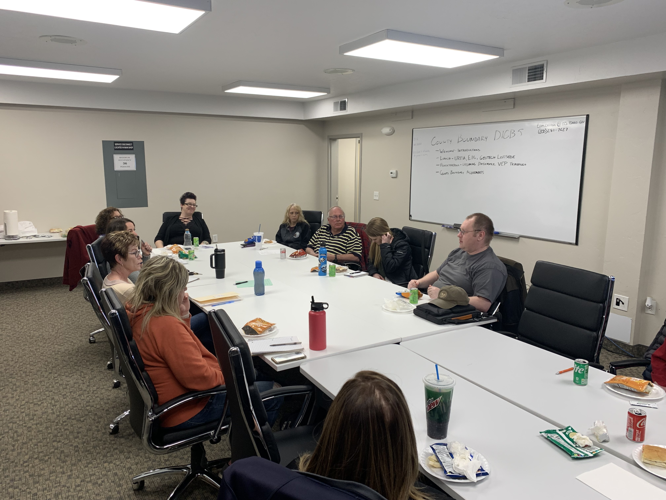
Getting Started
All 48 PSAPs visited
Over 4,500 miles traveled throughout the State
200+ contacts made
Integrity | • | Teamwork | • | Service
Notes:
Information about visiting each PSAP. Troubleshooting, Communications, Wins, Losses, etc.

Slide 5
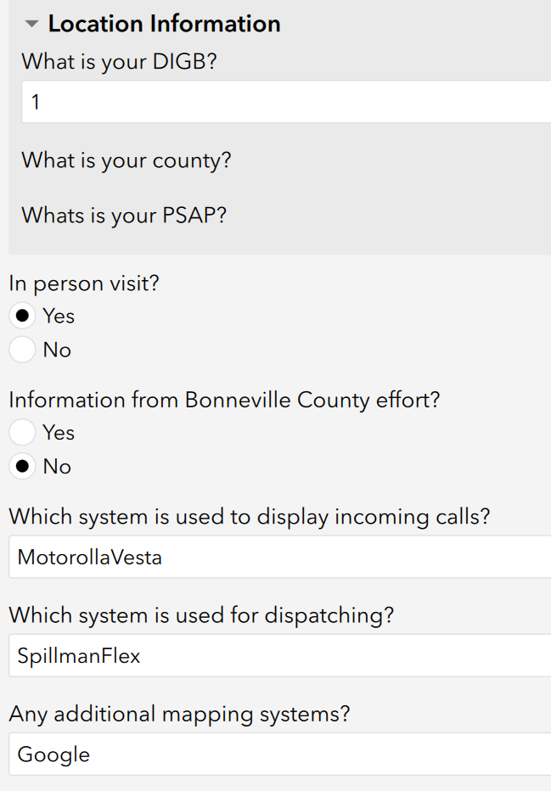
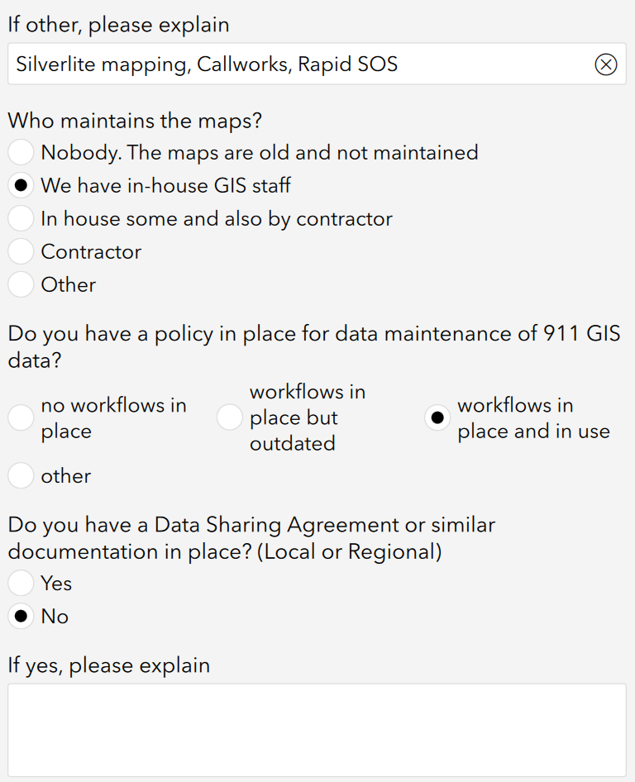
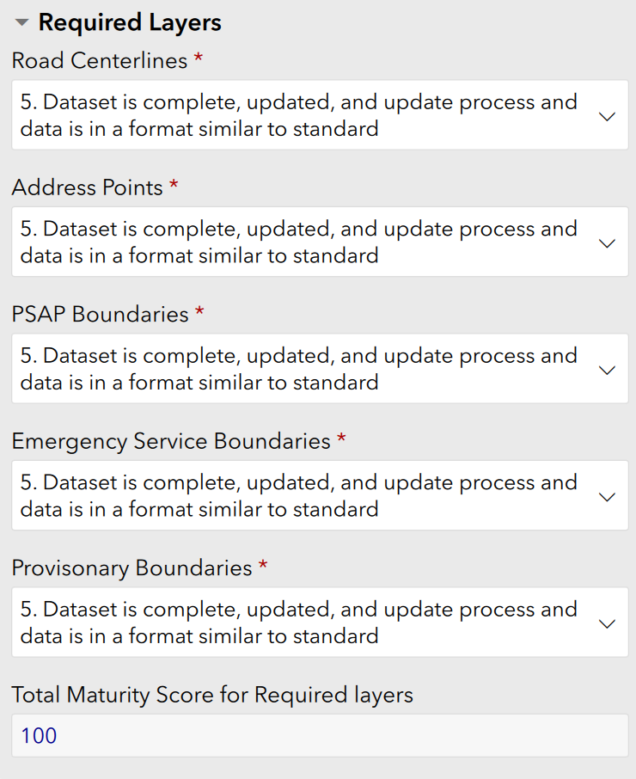
Baseline Survey
Integrity | • | Teamwork | • | Service

Slide 6
Gathering Data
48 Total PSAPs
2663 Service Boundaries submitted
266 Total data layers
947,338 Site Structure Address Points
241,146 Road Centerline Segments
Integrity | • | Teamwork | • | Service
Notes:
Multiple Stakeholders exist in the 48 total PSAPs
2663 Emergency service boundaries including Fire, Law, and EMS zones
947,338 individual site structure address points and landmark locations
241,146 Road Centerline segments
266 Total Data layers submitted
These numbers will grow as more data is identified and anomalies are addressed.

Slide 7
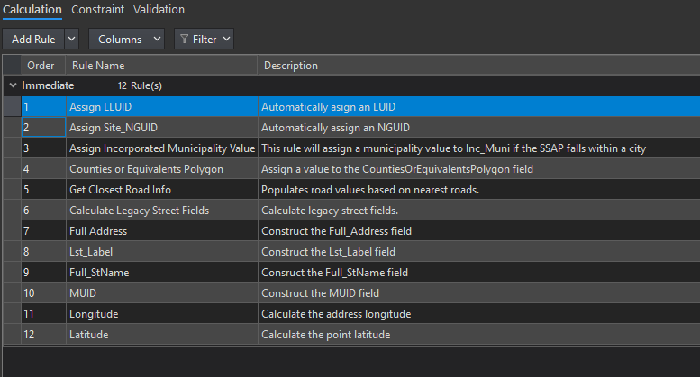
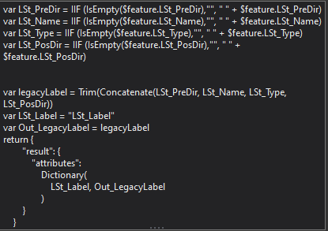
Addressing Solution
Integrity | • | Teamwork | • | Service
Notes:
After conversations with the State of Montana, the GIS contractors group deployed an "Addressing Solution" which utilizes attribute rules to auto-populate and calculate field values, including intersections with polygons.

Slide 8
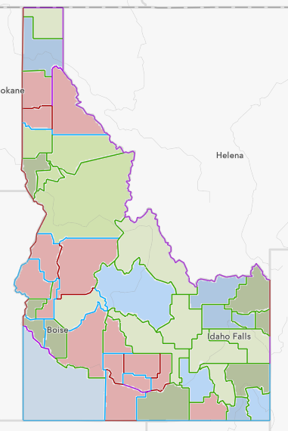
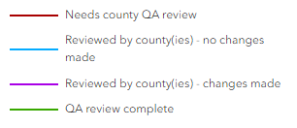
County Boundary Project
Boundaries established by Idaho Statute
County GIS Boundaries from various sources
Degradation and duplication problems
Segmentation
Rectification and recording of decisions
Authoritative vs. Trusted
Integrity | • | Teamwork | • | Service
Notes:
Boundaries from each county were collected, when possible the current boundary that was being used by local GIS was solicited, but many counties use census and tax commission boundaries and they were utilized when no other boundary was available.
County boundaries have become corrupted with errors of the human kind.
State statute legal descriptions were used to develop segments of boundaries for each of the counties. It was decided to use IDWR's PLSS system for boundaries that followed section lines, NHD for Rivers and Watershed divides for ridgelines.
Segments reviewed one by one with neighboring counties, with much success throughout the state.

Slide 9
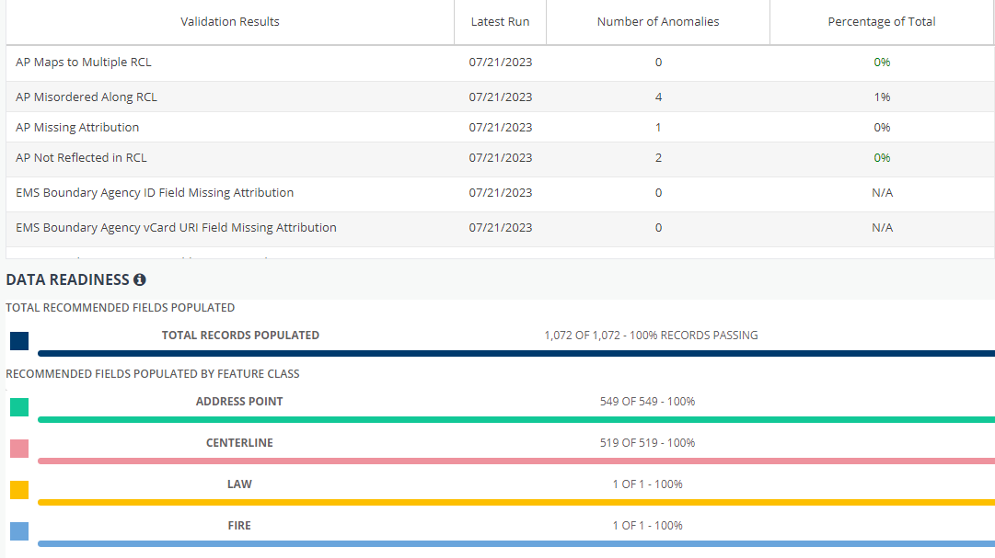
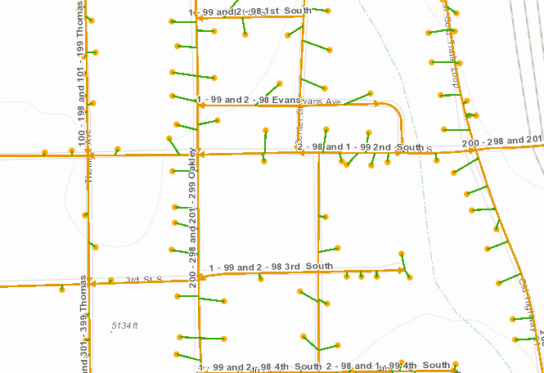
DATAMARK
Partnering
Integrity | • | Teamwork | • | Service
Notes:
We contracted with DATAMARK for three years to use their information quality control software. VEP is an online tool that allows PSAPs to view and edit their GIS data to ensure that it meets NENA NG9-1-1 standards. The application to run validation checks and data remediation and maintenance. We acquired individual licenses for all PSAPs. Multiple users can run validations and subsequently edit and remediate their data simultaneously through a customized web portal and notification workflow.. Once approved, edited or newly added map features are available in the default database to continue with the data remediation and data maintenance life cycle.
VEP VALIDATION PROPOSED WORKFLOW
Boundary layer topology
Road Centerline topology
Road Centerline ranges
Address Point anomalies and Fishbone Analysis related validations
MSAG/ALI anomalies
‘Exception’ management
-
Common anomalies returned by the VEP:
Gaps and Overlaps in PSAP Boundary, Law, Fire, EMS
Feature attribution anomalies: Missing mandatory field values
Discrepancy Agency ID, Country, State, County, Incorporated Municipality, etc.
AP not reflected in RCL – utilizes fishbone logic
Standardizing of street attributes (e.g., Parse and format pre-directionals, street pre-types, street post types, post directionals)
Prioritize bulk standardization up front to allow relationship between AP and RCL to be identified. This allows for fishbones to draw.
Note: If an AP Not Reflected anomaly is flagged, no proper relationship between AP/RCL was found, which prevents fishbones from drawing. If fishbones do not draw, this prevents other anomalies that utilize fishbones from flagging; AP Maps to Multiple, AP Misordered Along RCL.
Resolve RCL topology validations
RCL topology validations
RCL Intersecting
RCL Overshoot/Undershoot
RCL Multipart
RCL Self-intersecting
RCL is Too Short
RCL Too Close
RCL Digitized Direction
If RCL intersecting, be sure to update ranges of split segment to avoid creating additional anomalies
Resolve Boundary/RCL relationship anomalies
RCL not snapped to boundary
RCL not split along boundary
RCL not snapped to RCL on boundary
Resolve Road Centerline range anomalies
RCL Range Inconsistency
RCL Range Incomplete
Correct overlapping RCL ranges
Also resolves ‘AP maps to Multiple’ and ‘AP Misordered’ anomalies
Rerun VEP Validations
Rerun VEP validations after attribute updates and road centerline topology updates
Resolve AP Anomalies and all others remaining
Identify and fix duplicate address points
Typically, due to lack of sub-address values
Revisit AP not reflected in RCL anomalies
At this stage, those that are remaining should be true discrepancies between AP/RCL
AP mis-ordered along RCL – uses fishbone logic
Boundary/feature contained validation anomalies
RCL Not Contained Within Boundary
AP Not Contained Within Boundary
RCL Parity Inconsistency – mass calculation upfront
Recalculate parity values in bulk as you go through phases of editing
Calculate in data prep before reupload into VEP
Resolve MSAG/ALI Validation Anomalies
MSAG and ALI anomalies help identify where there are discrepancies between RCL/MSAG and AP/ALI
Do this after GIS layers have been remediated to produce the true discrepancies between GIS layers and Legacy tables
Rerun VEP validations and continue to iteratively work through the correction of anomalies.
VEP Validations can be run at any point throughout the above process to see how the data is progressing through updates. Consider this iterative workflow as a form of QC. Repeat the above steps as necessary.
--
COMMON ‘EXCEPTION’ MARKED ANOMALIES (VEP)
AP Misordered Along RCL
Long driveways/large parcels
Placement of buildings
Curvature of road in relation to full road range
AP Not Reflected – Wrong Side
RCL Digitized Direction
Increasing APs on one side and decreasing on other
Endpoints/Startpoints meet but represents associated APs
RCL Intersecting
Highway overpass/underpass most common
RCL Self-Intersecting
Highway on ramp where it loops around
RCL Too Short
“Connector” segments between street intersections
RCL Too Close
e.g., A highway on ramp that mostly parallels the highway before splitting off

Slide 10
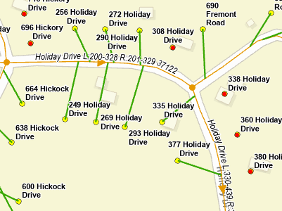
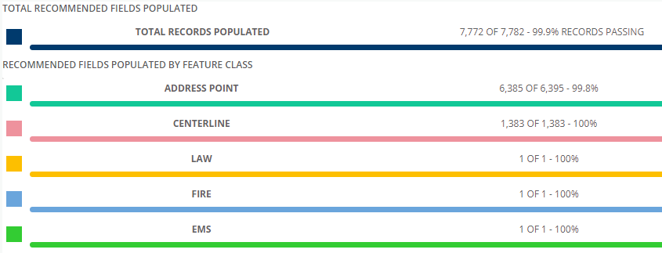
Continued Data Remediation
Local Anomalies Identified
Local Data Edited
Statewide Data Aggregation
Regional Data Aggregated
Data Validated
Regional Anomalies Identified
Integrity | • | Teamwork | • | Service

Slide 11
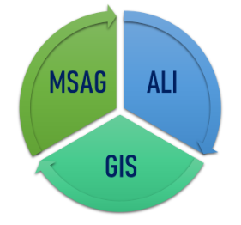
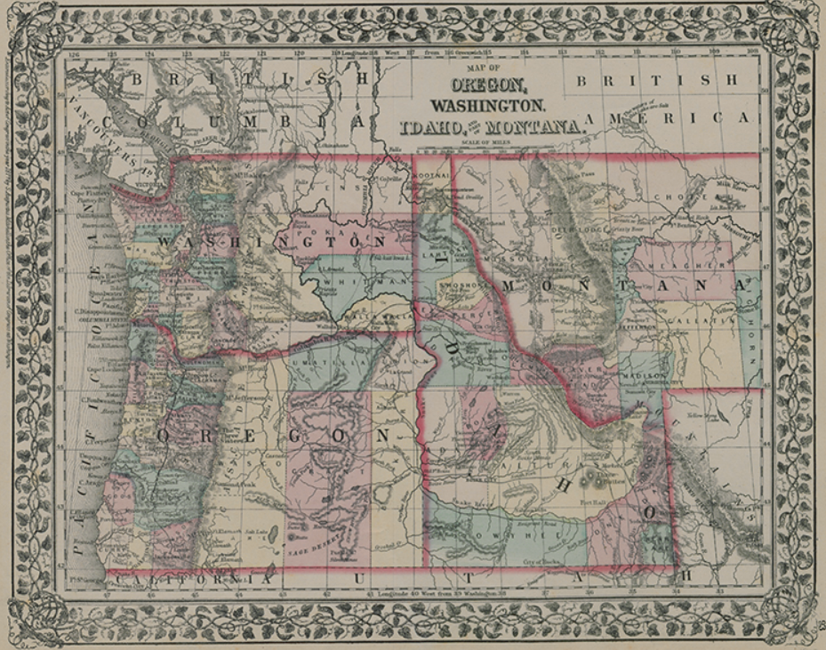
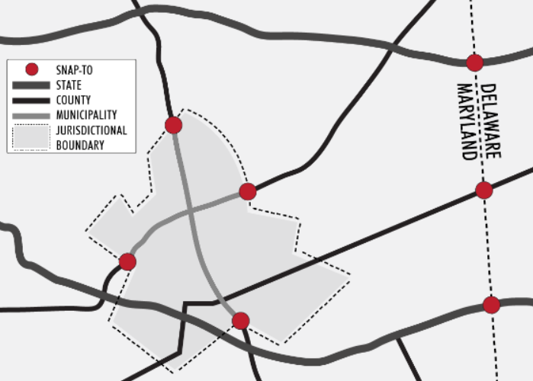
Next Steps
Synchronizing MSAG / ALI / GIS
ESZ boundaries / aggregation
Collaborate with neighboring states
Integrity | • | Teamwork | • | Service
Notes:
What are the continued issues that we are working on. i.e. State Boundaries, ESN boundaries
Master Street Address Guides (MSAGs), Automatic Location Identification (ALI), and GIS databases need to be synchronized. It is recommended that there be a 98% match between all of these databases.
Discrepancies between the GIS, the MSAG, and the ALI data can cause call routing and dispatching problems. Inaccuracies in the databases could lead to a delayed or improper response.

Slide 12
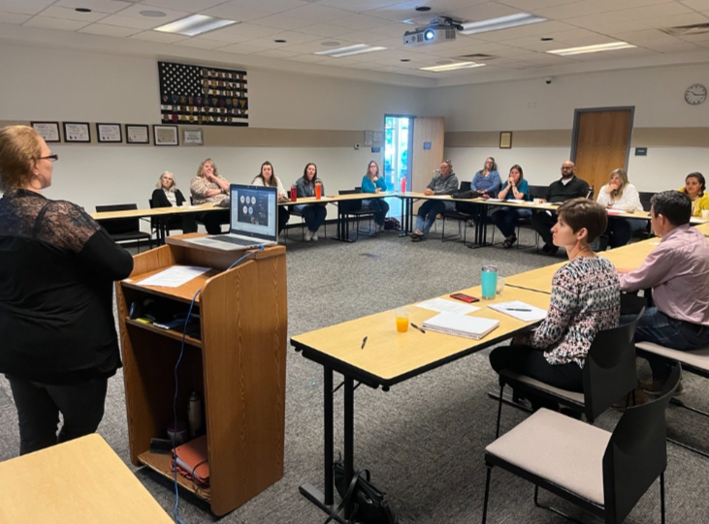
Integrity | • | Teamwork | • | Service

Slide 13
Questions?
Idaho NG 911 GIS HUB
Idaho NG 911 Dashboard
Tom Calton, GISP
Contractor
Paul Reyes,
Contractor
Wilma Robertson, GIO State of Idaho
Integrity | • | Teamwork | • | Service

