Slide 1
The 9-1-1 Program & GIS in Next Generation 9-1-1

Slide 2
The Role of the State 9-1-1 Program
Established by the 1981 Oregon Legislature, the program continually coordinates, administers and manages:
the network necessary to deliver 9-1-1 calls from the public to the correct PSAP
the equipment needed in a PSAP to process and answer 9-1-1 calls
the distribution of the state 9-1-1 Emergency Communications tax revenue
information and resources provided to the local 9-1-1 jurisdictions
information regarding technological advancements impacting the emergency communications system
Oregon Revised Statute (ORS) 403
Oregon Administrative Rules (OARs) 104, Division 80

Slide 3
Oregon Administrative Rules (OARs) 104, Division 80
(5) The Department shall coordinate and oversee the implementation of 9-1-1 GIS in Oregon, which may include the following activities:
(a) Identify and adopt technical standards and requirements;
(b) Identify and establish procedures for 9-1-1 GIS data maintenance;
(c) Identify and establish development of critical GIS data layers for use in current and future mapping systems and 9-1-1 functional elements; and
(d) Define and establish a standard GIS data model[2] to be used for the development, transfer, and storage of critical GIS data layers.
[Publications [1]: Publications referred to or incorporated by reference in this rule are available from the Department and are also available at https://www.oregon.gov/OEM/Documents/oregonali_aliaqor.pdf]
[Publications [2]: Publications referred to or incorporated by reference in this rule are available from the Department and are also available at https://cdn.ymaws.com/www.nena.org/resource/resmgr/standards/nena-sta-006_ng9-1-1_gis_dat.pdf

Slide 4
The GIS/MSAG Funding Policy
Funding Model
Disbursement limit groupings based on population by county
Including multiple County/PSAP allowances
Reimbursement amounts determined by local rate applied to recorded hours
Special Project Funding subject to availability of subaccount funds
Jurisdiction Disbursement Agreement
Disbursement Process
Submission of GIS Data
Submission Work Summary
Allowable Use
MSAG Coordination and Updates
GIS Data Layer Development/Maintenance
Provisioning Boundary
Road Centerlines
Site/Structure Address Points
Service Boundaries: Primary Service (PSAP), Police, Fire, EMS
And other Approved Tasks and Expenditures

Slide 5
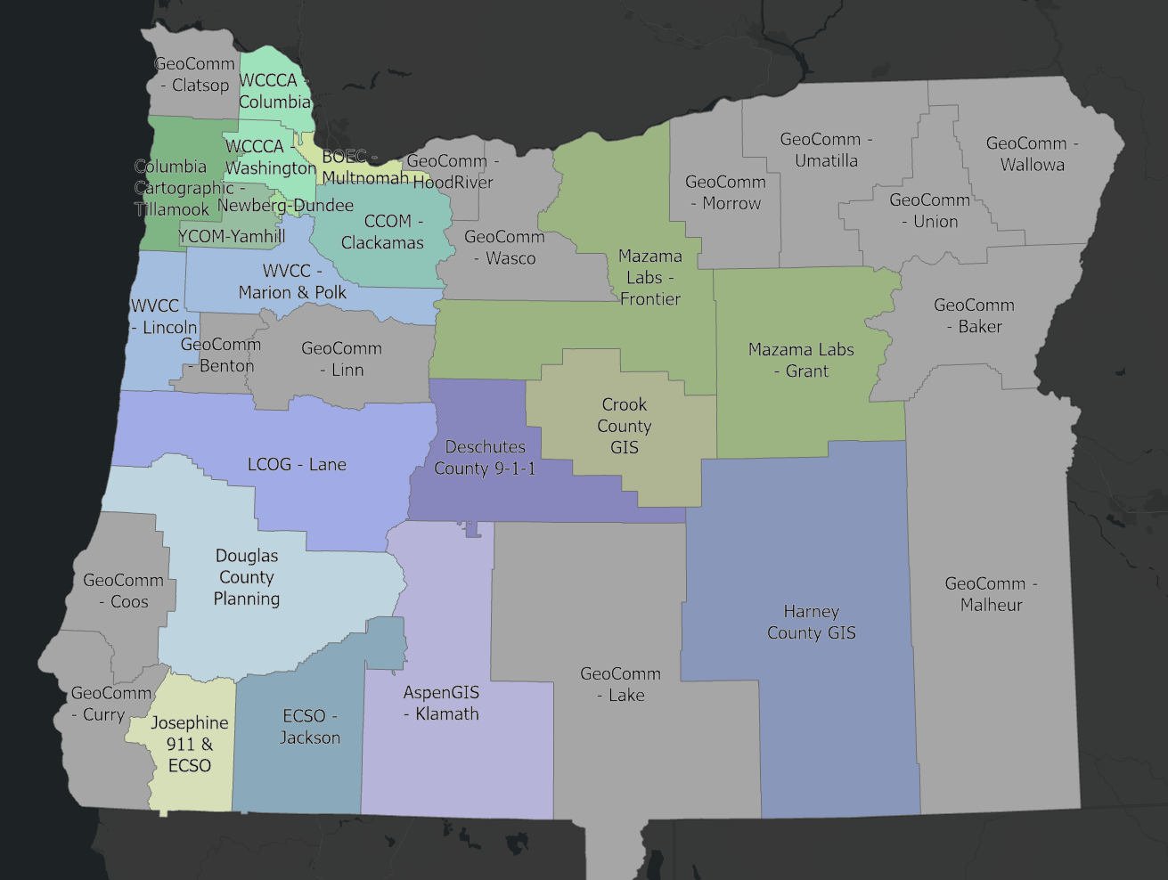
9-1-1 GIS Landscape
43 PSAPs across 36 Counties
15-18 9-1-1 Data Providers
28 Data Submissions Covering Oregon (with exception of Warm Springs)
GeoComm Provides for PSAPs in 14 Counties
Remaining mix of PSAP personnel, local gov’t, and local vendors
Status Map

Slide 6
9-1-1 Databases: GIS & ALI/MSAG
Master Street Address Guide (MSAG)
Updated Locally by MSAG Coordinators
Direction, Street, Low, High, Community, State, Parity, ESN
Automatic Location Identification (ALI)
Updated by wireline carriers
New records are created by tracking ESN from MSAG
9-1-1 GIS
Computer Aided Dispatch (CAD) specific data/schemas
Program funded mapping applications: VestaMap, Viper

Slide 7
Enhanced 9-1-1: wireline routing
The establishment of Enhanced 911 (E911) services in the mid 1970s that included 911 selective routing, automatic location information (ALI) and automatic number identification (ANI).
When a landline service is installed, the wireline provider submits the customer record along with the automatic number identification (ANI)
The address is looked up in the MSAG, the ANI and ESN are added to the selective routing database (SRDB) and the customer record is added to the ALI
When a 9-1-1 call comes across the public telephone network, it gets switched from a Central Office to a dedicated selective router which queries the SRDB using the ANI to find the ESN
Voice and ANI are then routed to the proper PSAP
Another query is made from the PSAP’s equipment to the ALI database, again using the ANI as a search key
The associated ALI record is then returned to the PSAP where the location is displayed for the call taker

Slide 8
Enhanced 9-1-1: wireless routing
In the 90’s, E9-1-1 faced the challenge of routing emergency calls made from wireless phones with no fixed service location
The Federal Communications Commision (FCC) mandated wireless carriers to provide location in two phases
Phase I required the delivery of 9-1-1 caller’s voice and originating cell site location to the most appropriate PSAP
Phase II required location of caller using device GPS or network-based location technology such as cell-tower triangulation
Incoming wireless 9-1-1 calls are received via cell towers by mobile switching centers (MSC)
The MSC automatically assigns a “pseudo ANI”
The selective router connects the call to a PSAP based on a cell tower’s location (Phase I)
The PSAP queries for caller location (Phase II)

Slide 9
Modernizing Oregon’s 9-1-1 System

Slide 10
Notes:
ON July 19th, the FCC release a Report and Order taking steps to advance the nationwide transition to NG9-1-1. The report and order set rules that define the responsibilities and set deadlines for fir all flavors of Service Providers.

Slide 11
NG9-1-1: Location Validation Function (LVF)
The Location Validation Function serves the transitional purpose of validating subscriber addresses against the GIS Address Points and/or Road Centerlines
It will take a while for all service providers to transition customer databases from legacy formatted address data to NENA formatted or Civic Location Data Exchange Format (CLDXF) compliant location information
Legacy location information follows the format used in the MSAG, while NENA requires fully spelled out, fully parsed out location information
Much like the MSAG is used now to validate new ALI records, the LVF takes the legacy formatted address data and the GIS data which includes both legacy and NENA formatted fields to validate the address record and add it to a Location Information Server (LIS)
The Location Information Server replaces the ALI database with pre-validated civic locations which can be retrieved if a 9-1-1 call comes in without location information

Slide 12
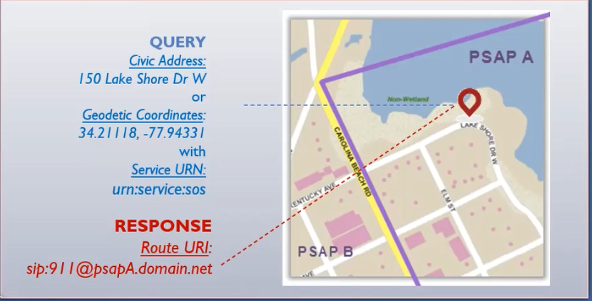
NG9-1-1: Emergency Call Routing Function (ECRF)
The Emergency Call Routing Function uses the service boundaries: the PSAP boundaries, and Fire, EMS, and Police call transfer boundaries to route calls
When a 9-1-1 call is placed in an NG9-1-1 system, it contains location information as Presence Information Data Format-Location Object (PIDF-LO)
That location information- either a geodetic or civic location, is passed to the ECRF along with a service URN indicating the type of service being requested
The ECRF performs a point in polygon query on the appropriate service boundary to get the proper URI for routing the call

Slide 13
NG9-1-1: NENA NG9-1-1 GIS Data Model
NG9-1-1 largely relies on the National Emergency Number Association (NENA) i3 Standard for Next Generation 9-1-1, and the associated GIS standard is the NENA NG9-1-1 GIS Data Model Standard
To use GIS to route 9-1-1 calls consistently across jurisdictional boundaries, statewide standardized datasets are required (in WGS84)
The Provisioning Boundary is used to aggregate data – no gaps or overlaps
Site Structure Address Point
RoadCenterLine
Service Boundaries (can be maintained together)
Primary Service Boundary (PSAP boundary) - no gaps or overlaps
Fire
Police
EMS

Slide 14
NENA Site Structure Address Points
Data Model: Attribute List on Page 32

Slide 15
Legacy vs NENA Address Fields
Legacy Fields
NENA Fields→ PIDF-LO (CLDXF)
Legacy Street Name Pre Directional
Legacy Street Name
Legacy Street Name Type
Legacy Street Name Post Directional
MSAG Community
ESN
Address Number Prefix
Address Number
Address Number Suffix
Street Name Pre Modifier
Street Name Pre Directional
Street Name Pre Type
Street Name Pre Type Separator
Street Name
Street Name Post Type
Street Name Post Directional
Street Name Post Modifier
Example: N ELMWOOD AVE → North Elmwood Avenue

Slide 16
Considerations for Oregon
Emergency tax funds to support data development (scoped to 9-1-1 call handling)
Small number of Counties, PSAPs, and 911 data providers
An almost complete set of address data
NG9-1-1 development ahead of procurement/implementation
A singular 9-1-1 System and funding to procure enterprise 911(call-handling) mapping solutions available statewide
Many state address standards are built off the NENA Data Model Site Structure Address Point Standard

Slide 18
Where We Are Today…

Slide 19
Alex Petzold, 9-1-1 GIS Coordinator
Email:
Alex.Petzold@oem.Oregon.gov
9-1-1 Program Website:
https://www.oregon.gov/oem/911/Pages/About-911.aspx
NG9-1-1 Info Hub:
https://or-ng911-geo.hub.arcgis.com/

