Slide 1
Matt Williams - DOGAMI
May 22, 2024
Oregon Framework
16 themes that form the foundation for an authoritative seamless statewide GIS

Slide 2
Addresses and Buildings Theme
New Theme to the Framework Program
Formed from Two Related Major Framework Elements
  Address Points
  Building Footprints
Both Need –
  Standards
  Statewide Public Datasets
    Statewide Oregon Address geocoder
Notes:
You can be involved in one, the other, or both

Slide 3
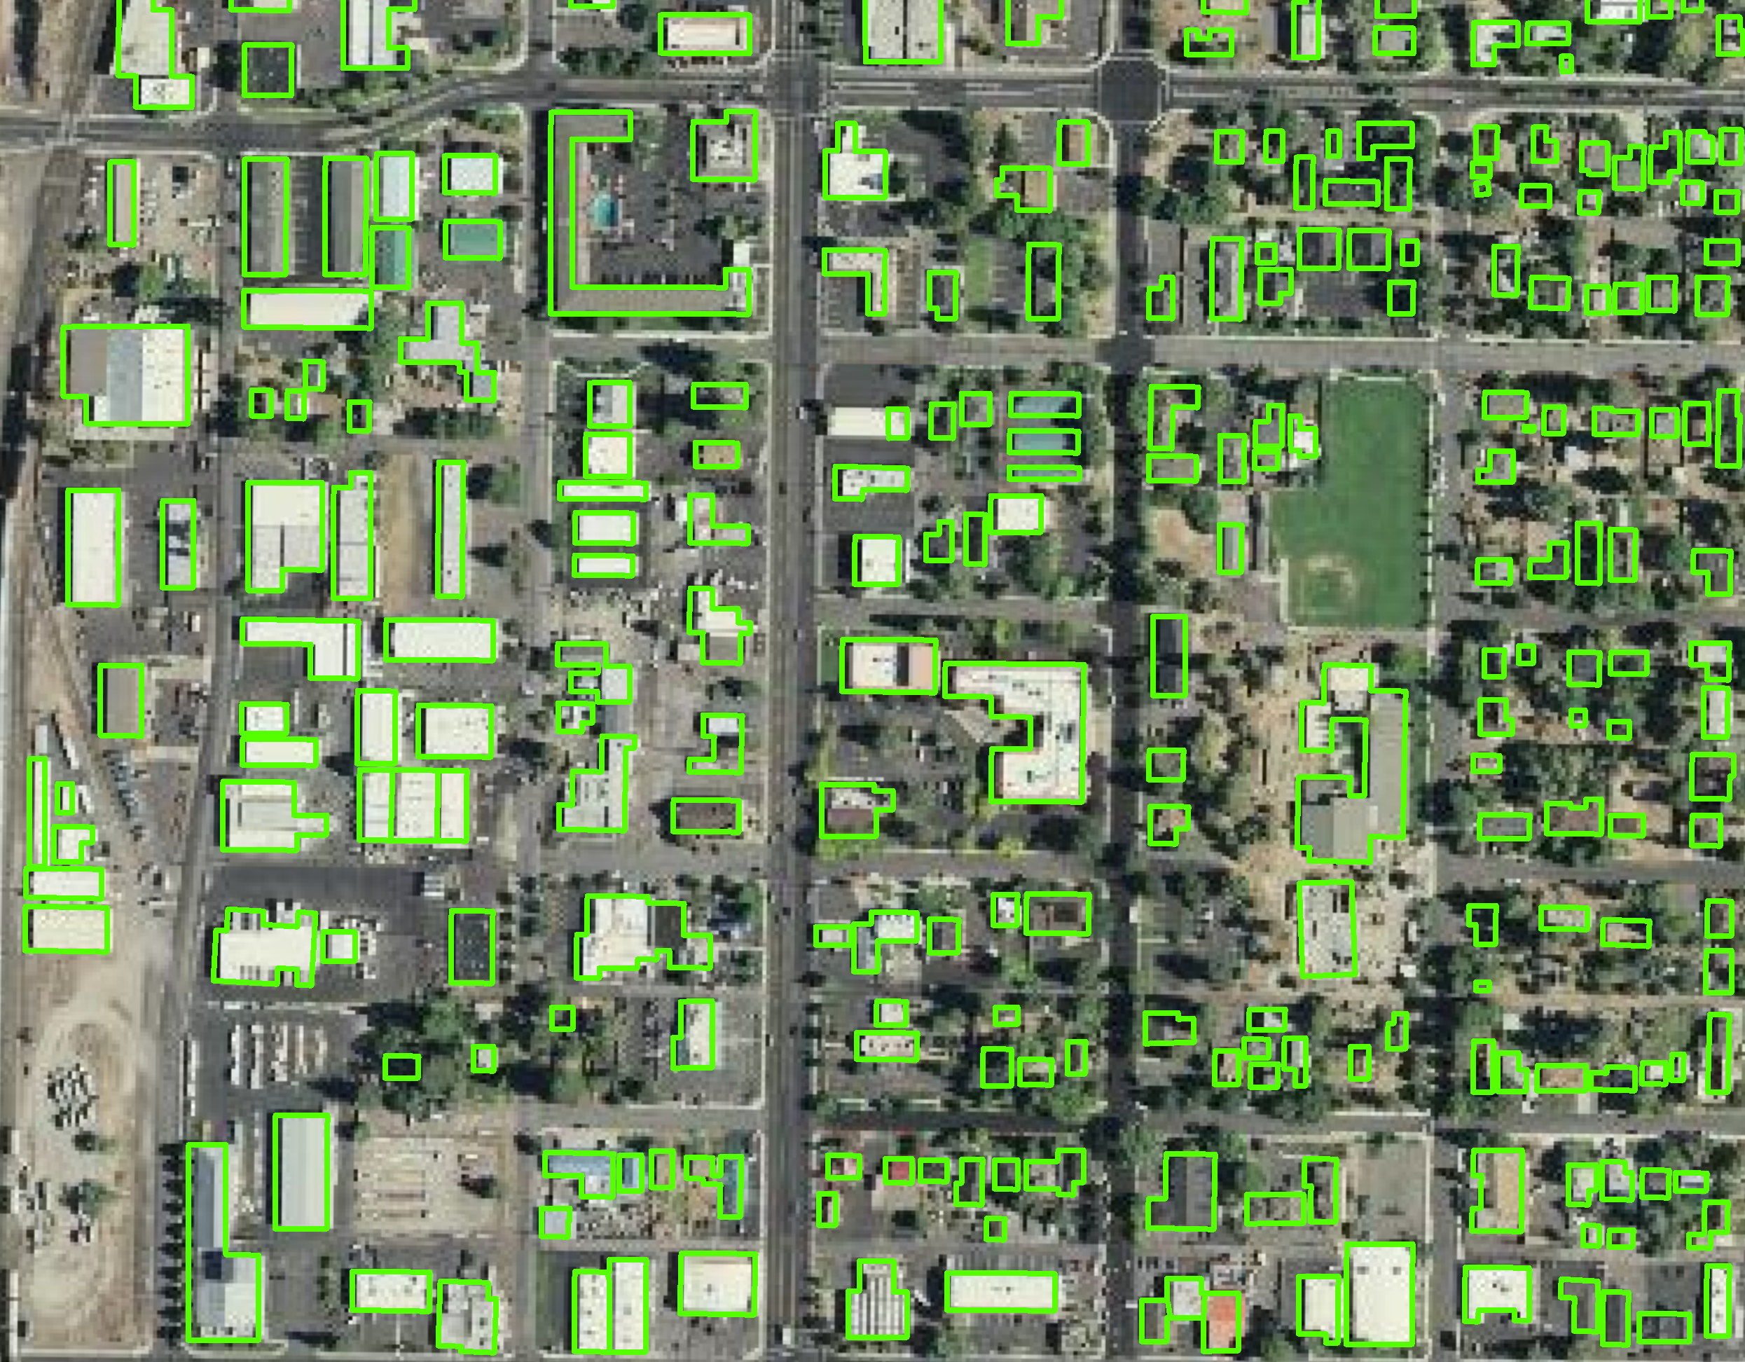
Presentation Overview
Background
Oregon building footprint coverage pre-2021
GEO-FIT Project
Scope of work and deliverables
Methods and Results
Data Standard development
U.S. statewide datasets
Getting started on a data standard
Source: Williams, 2021
Notes:
You can be involved in one, the other, or both

Slide 4
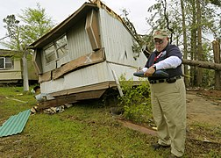
Benefits of developing building data
Natural hazard risk assessments and mitigation
Community planning & development
Emergency response and evacuation modeling
Post-disaster debris management
Enhanced base map visualization
Asset management
Demographic and social vulnerability analysis
FEMA performing damage assessment in Arkansas
Credit: Win Henderson, April 13, 2009

Slide 5
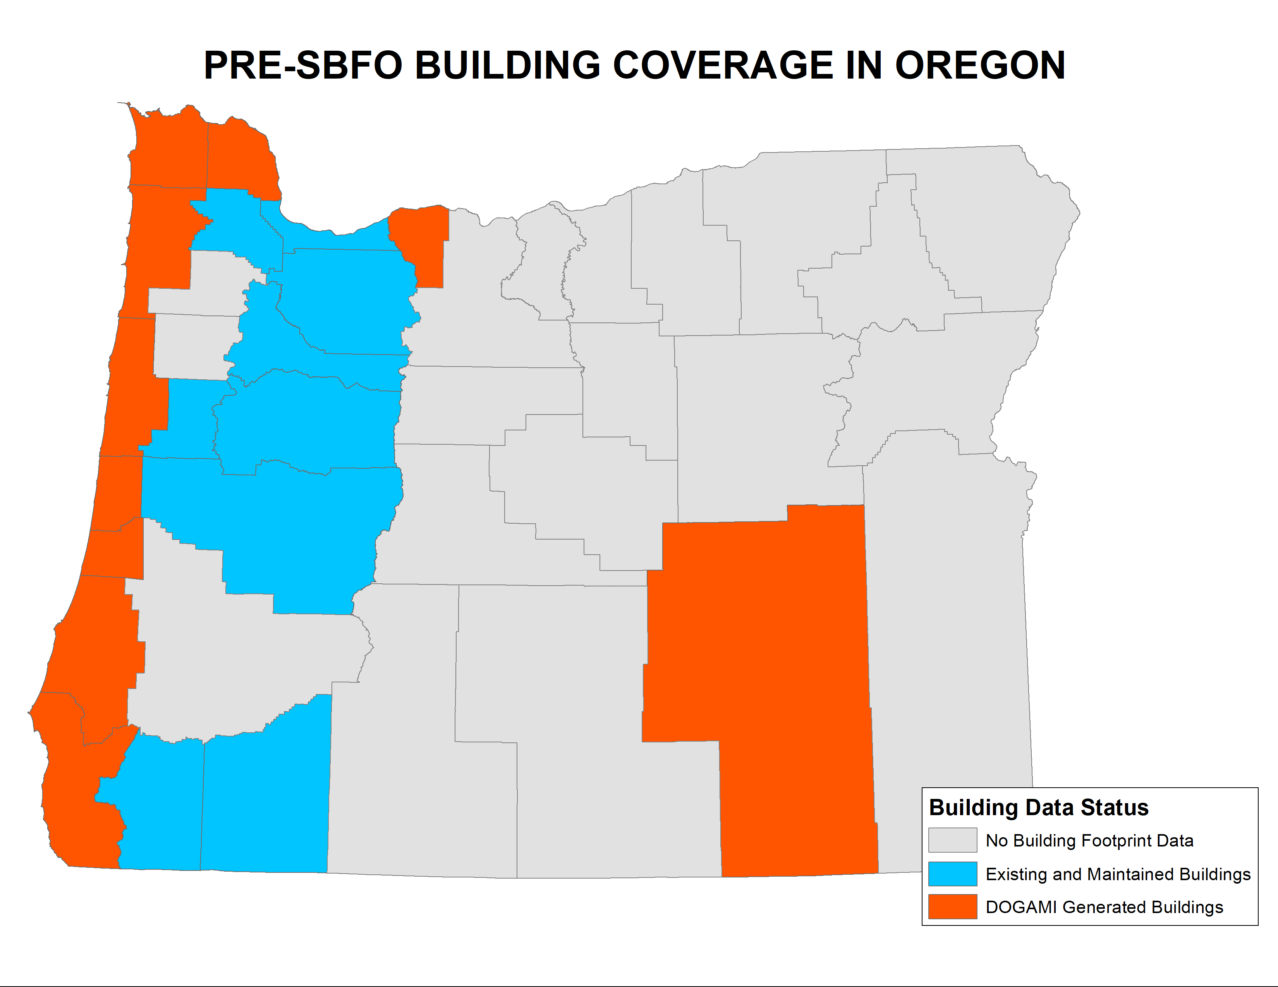
Oregon Buildings Pre-SBFO
Building footprints maintained by some county and regional planning agencies.
Lidar-derived building datasets maintained by DOGAMI
Microsoft Bing automated building footprint generation for the U.S.

Slide 6
Building Inventory
Total number of buildings in Oregon – ~2.5 million
DOGAMI building footprints (coastal portions of Oregon) – ~175,000
Metro building footprints – ~620,000
Jackson County building footprints – ~169,000
Josephine County (managed by Jackson Co.) – 88,000
Lane County building footprints (excluding coastal area) – ~130,000
Linn County building footprints – ~130,000
City of Salem – ~180,000
Source: Williams, 2021

Slide 7
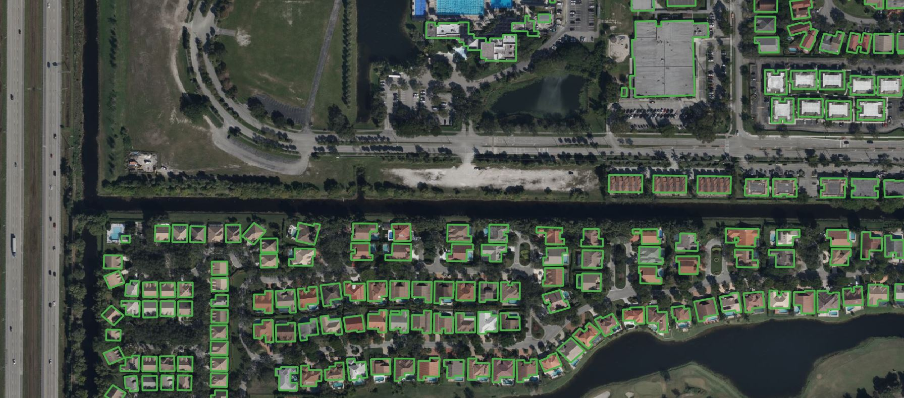
Microsoft Bing Buildings
  Open-source, nationwide building footprint dataset
  Machine learning process
  Derived from Bing imagery
  Accuracy estimate are 6.3% misidentified and 13% missed buildings (Williams, 2021)
  Errors tend to be missed buildings
  Open-source license
https://github.com/microsoft/USBuildingFootprints/blob/master/images/example.JPG
Author: nikolatr

Slide 8
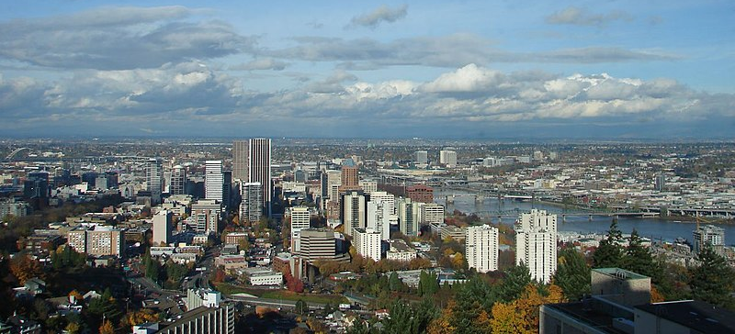
Goals of developing the SBFO
Total statewide coverage
A compilation of existing datasets
An edited version of Microsoft Bing buildings
2D representation of all “permanent” structures in Oregon
Based on most recent and best available imagery
  Deliverables
    Statewide building footprints GIS dataset
    Metadata for building footprints
    Open-file report documenting methods
Image source: Wikimedia commons, Jamidwyer, 11/9/2006

Slide 9
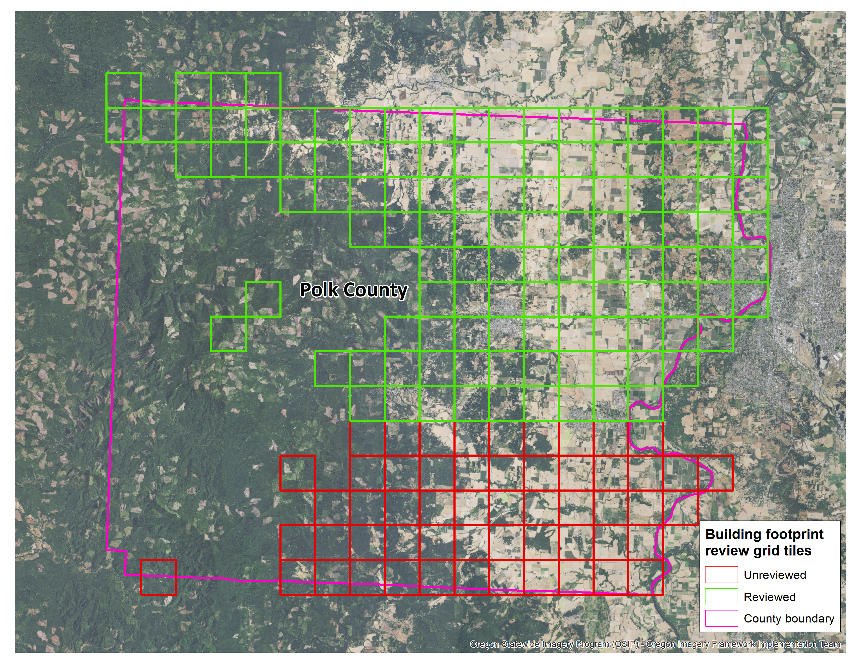
Data development
Regular Workgroup meetings through GEO
Review and editing the Bing buildings dataset
Coordination with counties and planning organizations to integrate existing building with the statewide compilation
Source: Williams, 2021

Slide 10
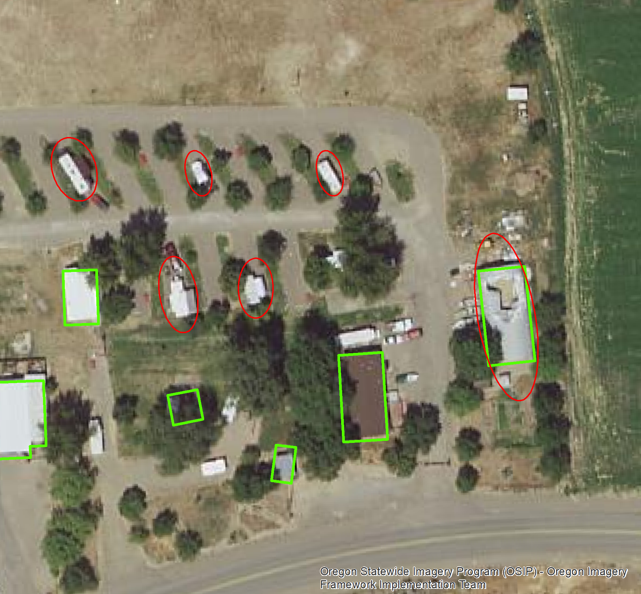
Building Footprints Defined
Buildings defined as…
Permanent and fixed
Greater than 400 square feet
4-walled roofed structure that people occupy
Infrastructure not included
Bus shelters, RV’s, non-structural greenhouses (hoophouses), and gazebos not included
Source: Williams, 2021

Slide 11
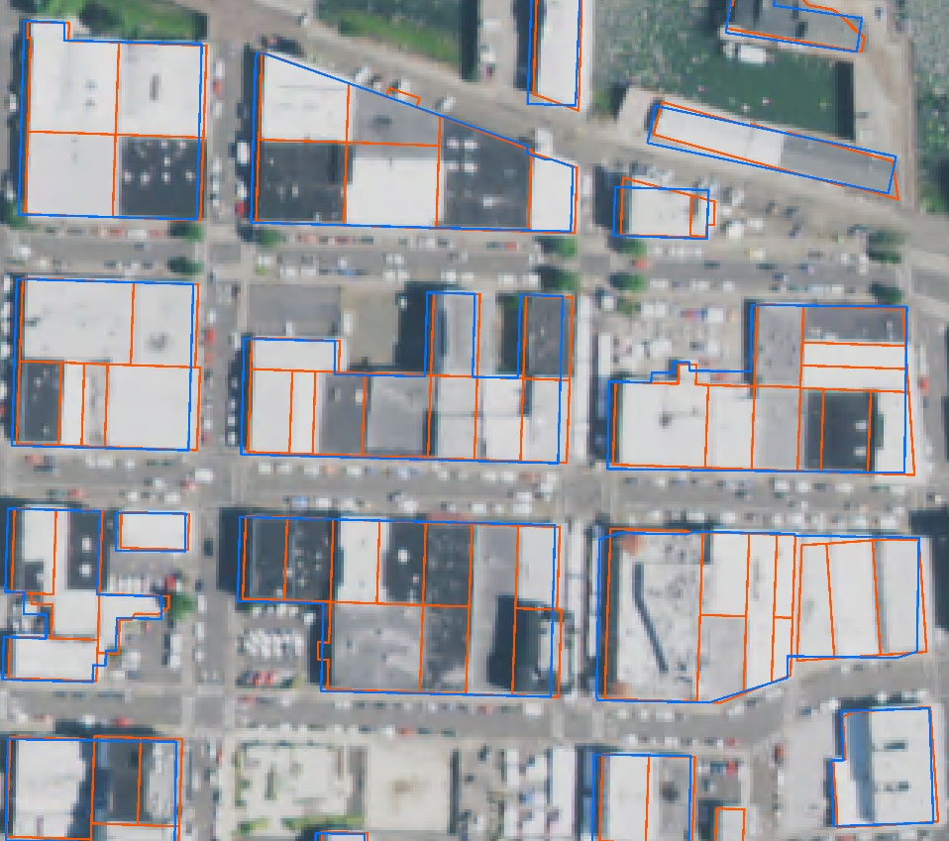
Building data development (geometry)
Deleting misidentified buildings
Adding missed buildings
Correcting outline errors (large buildings only)
Splitting joined buildings (shown in example)
Source: Williams, 2021

Slide 12
Building data development (attributes)
Contributor identified
Data used to generate building (source, source type, source date)
Building elevation, roof height (derived from lidar)
Date of review and imagery
Also: square foot, year built, county, unique ID
Source: Williams, 2021

Slide 13
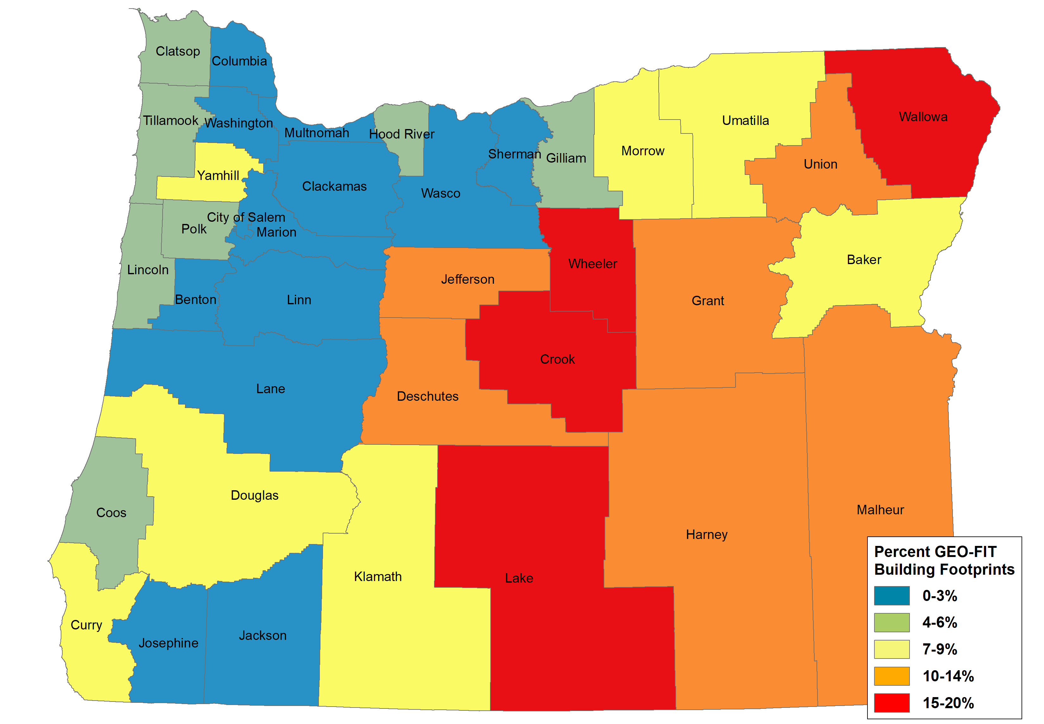
Results and Findings
Percent new buildings generated from GEO-FIT project
Total number of buildings in Oregon: 2.2 million
Total number of buildings digitized through GEO-FIT project: 71,424
Total number of building edited by GEO-FIT: 287,587
6.3% commission error and 13% omission error (Bing blds)
Data quality strongly dependent upon regular maintenance
Accuracy differences also attributed to lidar vs orthoimagery and vintage of imagery used to generate buildings.
Source: Williams, 2021

Slide 14
Identified Problems
No Data Standard
More useful attributes (e.g., occupancy type)
Connecting to related datasets
Frequent maintenance necessary to keep up with new development
Availability of new imagery to verify buildings
Maintaining persistent building IDs through an update

Slide 15
Possible Future Updates
Establish a Data Standard
Clear and regularly occurring data stewardship
Connecting to GEO and other state datasets (e.g. OEM wildfire damage assessment tool)
Imagery vendors source of new buildings
AI generated buildings
Generate subsets or derivative datasets from SBFO (e.g. critical facilities, state-owned, URMs)
Downloadable custom extents from HazVu (DOGAMI)

Slide 16
No U.S. Building Data Standard to Follow
Pros and Cons with no existing data standard
No guidelines to assist us in the decision-making process
We have a clean slate to work with
Free to customize a standard that will work for Oregon’s data needs
Can make it as complicated or simple as we need

Slide 17
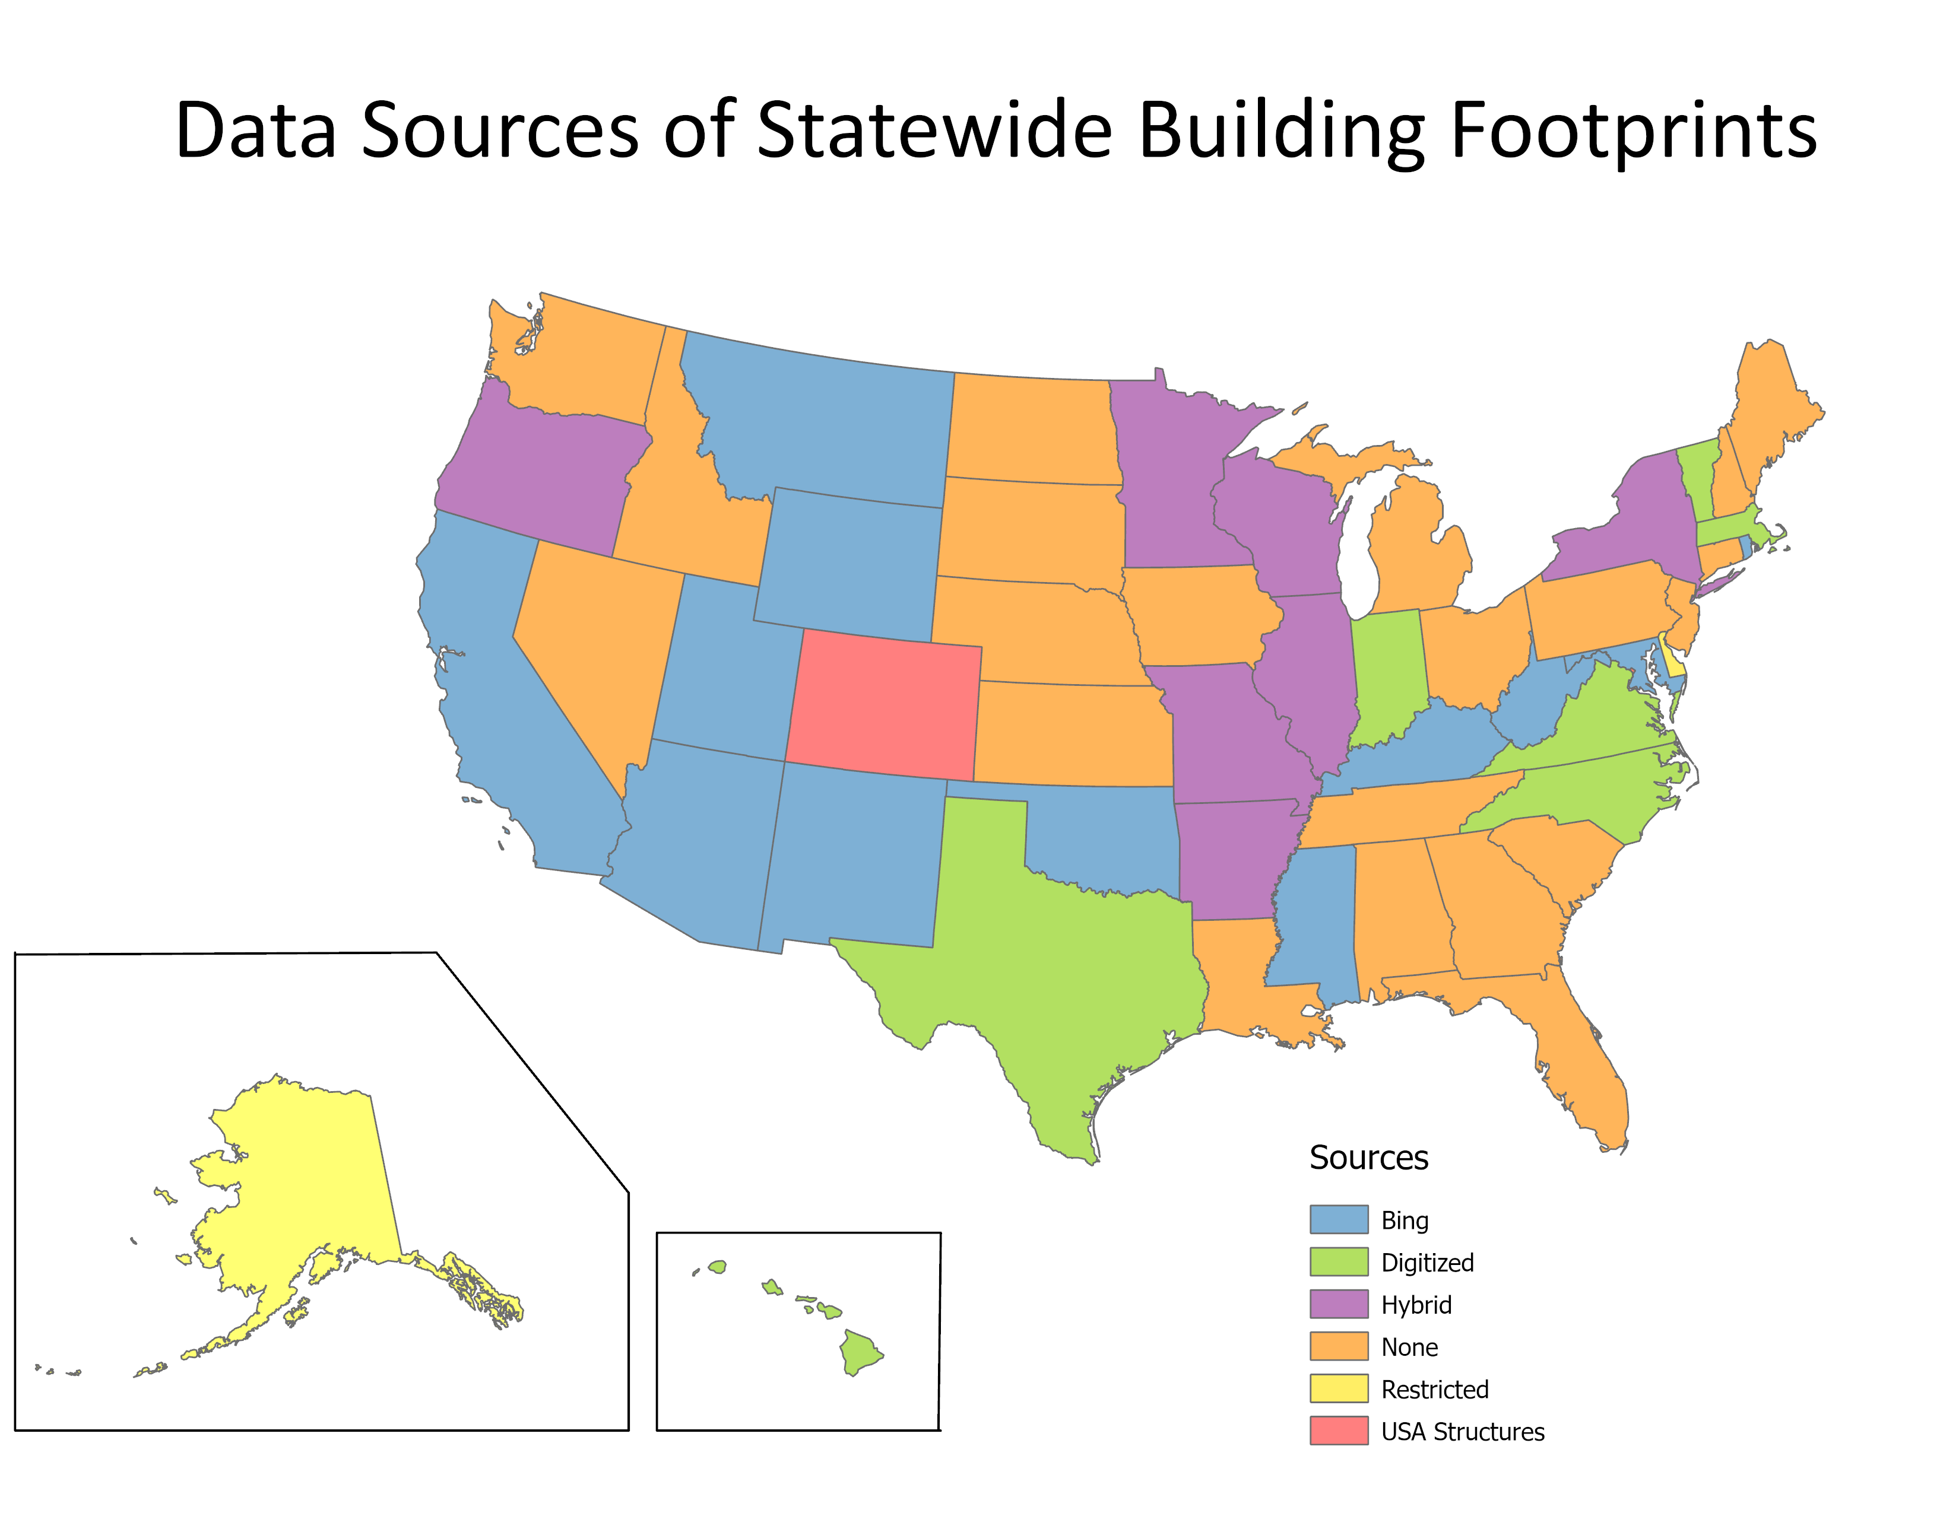
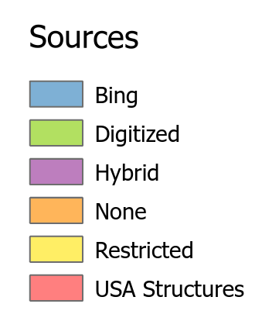
Statewide Data Sources
Most states, including Oregon, are using Bing buildings as a source of building data
Notes:
Complete
All Numbered Thoroughfare address points in Oregon
Including all unit numbers
Houses, apartments, mobile homes, accessory dwelling units, condominiums
Commercial, government
Offices, retail, manufacturing, farm
Schools, public facilities.
Residential, non-residential, group quarters
NOT
Residential addressees, tenants, no personal information
Landmarks, points of interest, mileposts, intersections
Infrastructure, machinery only

Slide 18
Various Building Footprint Attributes
Area (not the default geodatabase area)
County name
Source (data type, date of source, digitization method, contributor)
Editor (date of edits, who edited, validation imagery, imagery date)
Lat/Long
Elevation (lowest adjacent grade, centroid elevation)
Height (roof height - min, max, avg)
Address
Class/Type (e.g., residential, commercial, public, etc.)
Year Built
First Floor Height (typically used for flood risk analysis)
Stories
Basement
Flood (flood exposure)
Value
Parcel

Slide 19
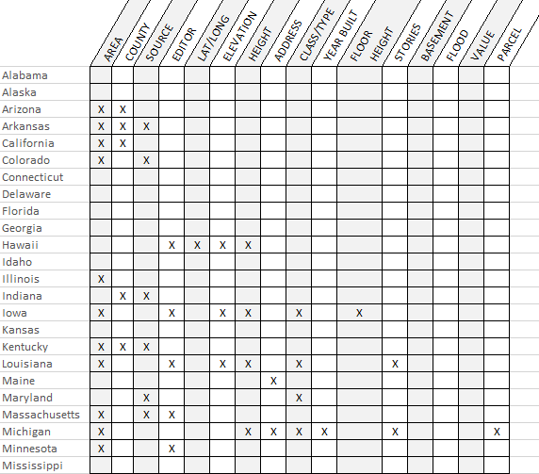

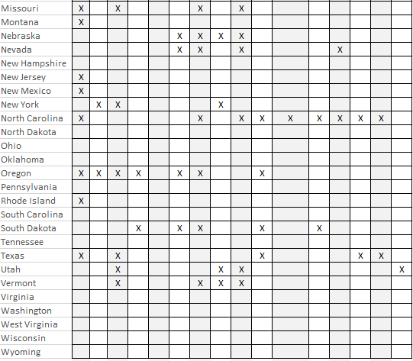
Attributes included in U.S. building datasets
Area 19
County 7
Source 12
Editor 7
Elevation 7
Lat/Long 1
Height 11
Address 6
Class/Type 10
Year Built 5
1st Floor Height 2
Stories 4
Basement 2
Flood 2
Value 2
Parcel 2
Notes:
Complete
All Numbered Thoroughfare address points in Oregon
Including all unit numbers
Houses, apartments, mobile homes, accessory dwelling units, condominiums
Commercial, government
Offices, retail, manufacturing, farm
Schools, public facilities.
Residential, non-residential, group quarters
NOT
Residential addressees, tenants, no personal information
Landmarks, points of interest, mileposts, intersections
Infrastructure, machinery only

Slide 20
Building Footprints Standards - Priorities
Compare existing building datasets from around US (no current Data Standard)
Identify needs from other Framework Themes that could be met by buildings
Identify needs from county and city partners around Oregon
Identify the priorities for the building elements
  Core Most important or mandatory minimum fields, must be supplied
  Important Recommended, can be derived from core
  Useful Optional or nice to have, can be derived from core or location
  Not important nor relevant
Add any other necessary fields

Slide 21
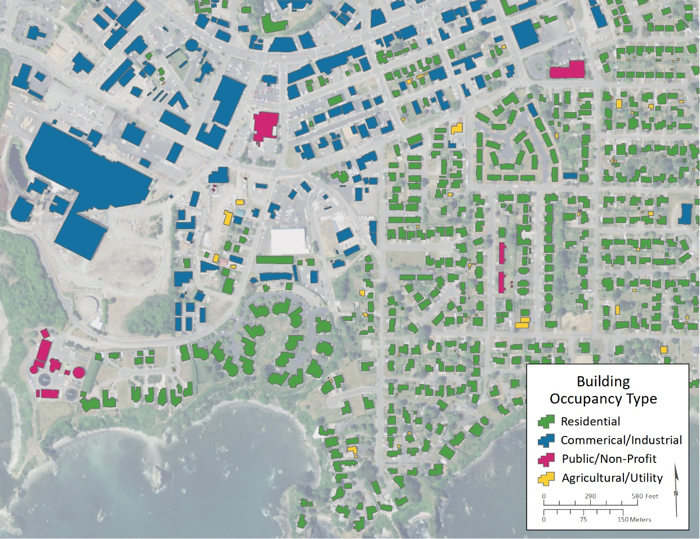
Other Data Standard considerations
Attributed Building Footprints
Currently the SBFO is “metadata” based
Leveraging expertise and identifying needs through FIT Workgroups
Coordination with city and county stakeholders
Occupancy type/Use type would be most valuable attribute
Fixed ID for existing buildings
Need available taxlot to tie related datasets together
Source: Williams, 2021
Notes:
Complete
All Numbered Thoroughfare address points in Oregon
Including all unit numbers
Houses, apartments, mobile homes, accessory dwelling units, condominiums
Commercial, government
Offices, retail, manufacturing, farm
Schools, public facilities.
Residential, non-residential, group quarters
NOT
Residential addressees, tenants, no personal information
Landmarks, points of interest, mileposts, intersections
Infrastructure, machinery only

Slide 22
Thank You!
Tom.Elder@das.oregon.gov
Matt.Williams@dgmi.oregon.gov

