Slide 1
Tom Elder, FIT Lead
March 18, 2024
Oregon Framework
16 themes that form the foundation for an authoritative seamless statewide GIS

Slide 2
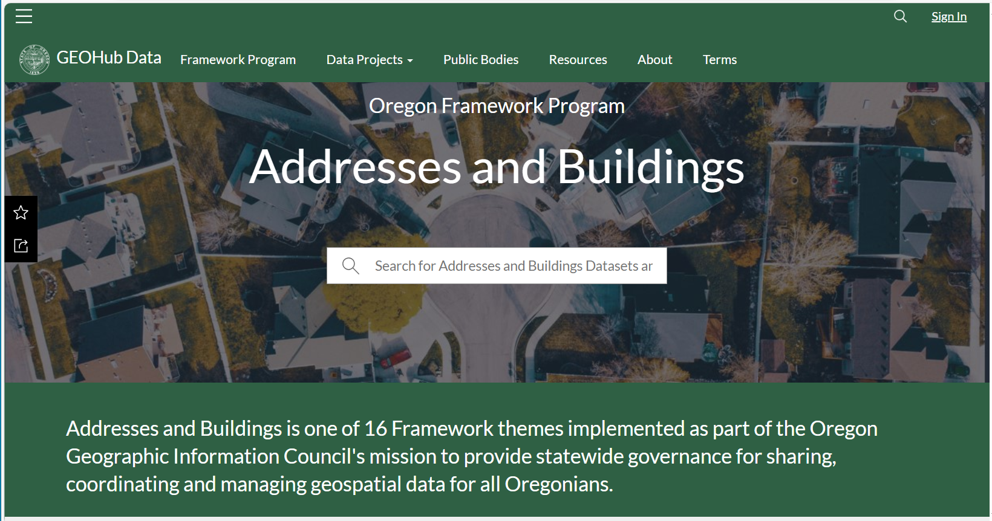
GEOHub FIT Page
https://geohub.oregon.gov – Framework Program heading

Slide 3
Introductions
Welcome and Thanks for joining us!
Membership is always open to anyone who has the time and interest
Two main groups
  Data Contributors – Supply
    Originators, Address Authorities
    Collectors, Aggregators
  Data Consumers – Demand
    Large projects that require statewide addresses
    Routine operations that need addresses that regularly cross boundaries
Notes:
Members can be from
State
Local
Regional
Tribal
Federal
Private

Slide 4
Framework Implementation Team
NAME | ORG | NAME | ORG
Alex Petzold | ODEM 911 | Matt Williams | DOGAMI
Alicia Wood | Metro | Melanie Wadsworth | Business Oregon
Chrissy Barrows | LCOG | Melissa Foltz | DAS, Framework Coordinator
Daniel Stoelb | ODEM, Preparedness FIT | Paul Cone | City of Portland
Ethan Sharygin | PSU, PDC Director | Rachel Smith | DAS, GIO
Hilary Leavell | City of Salem, WVCC | Tim Esau | Secretary of State
Ismael Padin-Dujon | ODHS | Tim Smothers | Baker County
Janette Cook | City of Portland | Tim VanDeWalle | Yamhill Communications
Juliana Wold | ODEM 911 | Tom Elder | DAS, FIT Lead

Slide 5
Addresses and Buildings Theme
Framework Program Overview
Formed from Two Related Major Elements
  Address Points
  Building Footprints
Both Major Elements Need –
  Standards
  Datasets
Both together will provide the highest level of spatial detail for characterizing the human geography of Oregon
Notes:
You can be involved in one, the other, or both

Slide 6
Statewide Public Datasets
A parcel can have multiple buildings
A building can have multiple addresses
An address can have multiple locations

Slide 7




Related Framework Themes
Cadastral
  Parcels
Transportation
  Street Centerlines
Administrative Boundaries
  City Limits
  County Boundaries
  Census
Preparedness
  Hospitals
  Fire Stations
  Schools

Slide 8
Partnerships & Collaborations
Oregon Geographic Information Council
Oregon Next Generation 911 Technical Advisory Committee
  Adopt NENA Standard for all Public Safety Answering Points
National
  NSGIC National States Geographic Information Council
  FGDC Address Subcommittee
  National Address Database
Other States

Slide 9
State Examples
Alaska – Basic Hub Page, Basic Product, Quick setup, Easy to use
DC – Rich Hub page, Many products, Other address classes
NC – Rich Hub page, Process & uses, Also building footprints
MA – Multiple products, Lists & Points - Basic & Advanced
NY – Multiple products, NYC – Open Data portal
OS – Most sophisticated, Full business model, Multiple products

Slide 10
Getting Started
Workgroups
Workplans
  Statewide Standards & Datasets

Slide 11
Goals – Authoritative, Reliable, Convenient Data
Complete Seamless Statewide Coverage
Publicly Available – No Cost
  Oregon Address geocoder
Sustainable Maintenance
Accurate – Address and Location
Flexible Design – Multi-Purpose
  Offer Many Products Basic, Enhanced, Specialized
  In Many Formats NENA, NAD, USPS, Census, others or custom
  For Many Uses
Notes:
Complete
All Numbered Thoroughfare address points in Oregon
Including all unit numbers
Houses, apartments, mobile homes, accessory dwelling units, condominiums
Commercial, government
Offices, retail, manufacturing, farm
Schools, public facilities.
Residential, non-residential, group quarters
NOT
Residential addressees, tenants, no personal information
Landmarks, points of interest, mileposts, intersections
Infrastructure, machinery only

Slide 12
Many Uses
Public Safety & Emergency Management
Elections & Voting
Census
Housing
Broadband
Marketing & Mailing
Public Health
Many others

Slide 13
Scope - Addresses
In Scope – Initial Phase
  Focus on FGDC Numbered Thoroughfare address class
    Street Number & Street Name with Unit Number (if present)
  Physical street addresses like 123 N Main St or 5432 E Oak Rd Apt 101
  All Residential, Non-Residential (Commercial & Government), Group Quarter addresses
  Point geometry
Not in Scope
  Other FGDC address classes (later phases) – Landmark/Point of Interest, Intersection, Range, PO Box
  Personal information - names, phone numbers, email addresses (Residential)
  Infrastructure only

Slide 14
Resources
Data – Supply Chain
  Address Points
  Building Footprints
Platforms
  GEOHub
  Oregon Open Data
Tools
  Databases
  USPS Coding Accuracy Support System (CASS) subscription – Smarty.com

Slide 15
Address Data
Supply Chain
Federal
Framework
Address Aggregators
Local Address Originators
National Spatial Data Infrastructure
National Address Database
Census
National
OGIC Endorsed statewide standard
Publicly available statewide datasets
State
911 Public Safety Answering Points Regional council of governments
Local
City, county, tribal
Planning, Building Permitting
Address Authorities

Slide 16
Current Supply Chain - Overview
ODEM 911 GIS Data Funding Policy
Quarterly PSAP 911 Data Submissions
ODEM NENA Statewide Aggregation
DAS Statewide Geocoder
Statewide Framework Datasets
National Address Database
Supply Chain will change for NG911! - To Be Determined

Slide 17
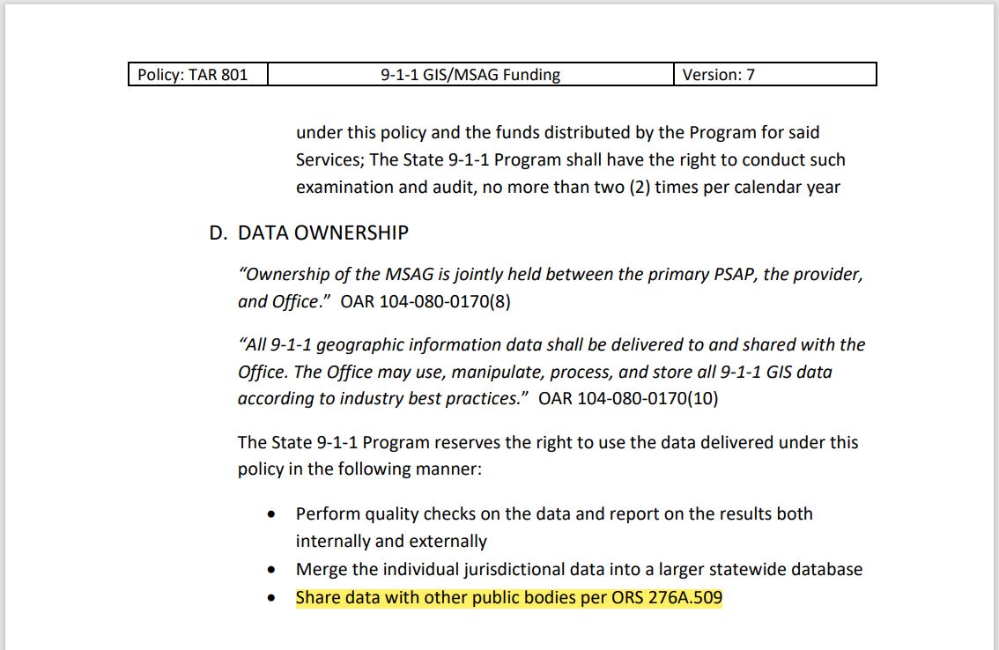
Current Supply Chain – ODEM Funding Policy
TAR 801 005 911 GIS MSAG Funding Policy 7/1/2023
All prior Data Use Agreements have been terminated

Slide 18
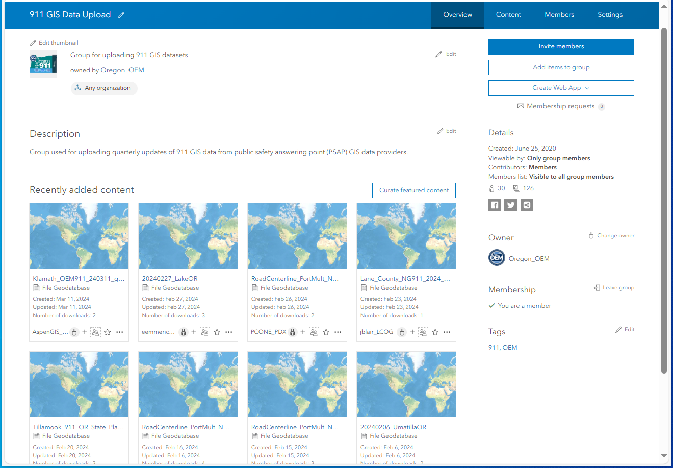
Current Supply Chain - Group
Per the Funding Policy -
PSAPs upload GIS data submissions quarterly to an ArcGIS Online group

Slide 19
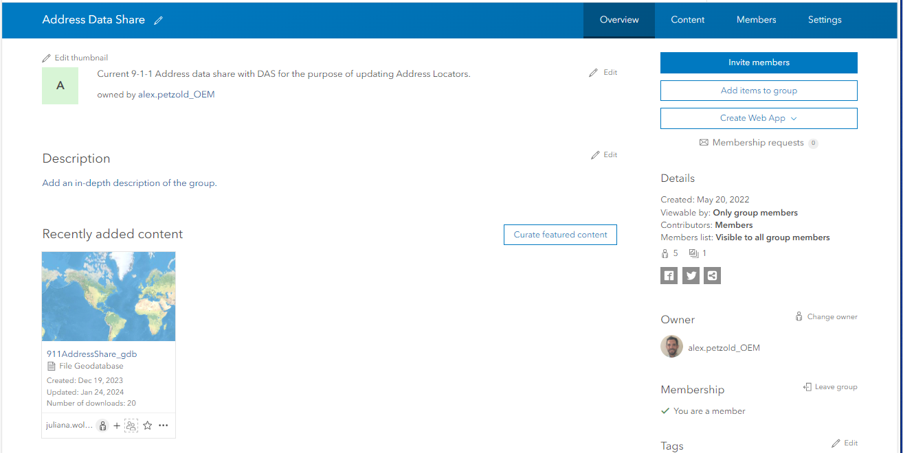
Current Supply Chain – Aggregated NENA

Slide 20
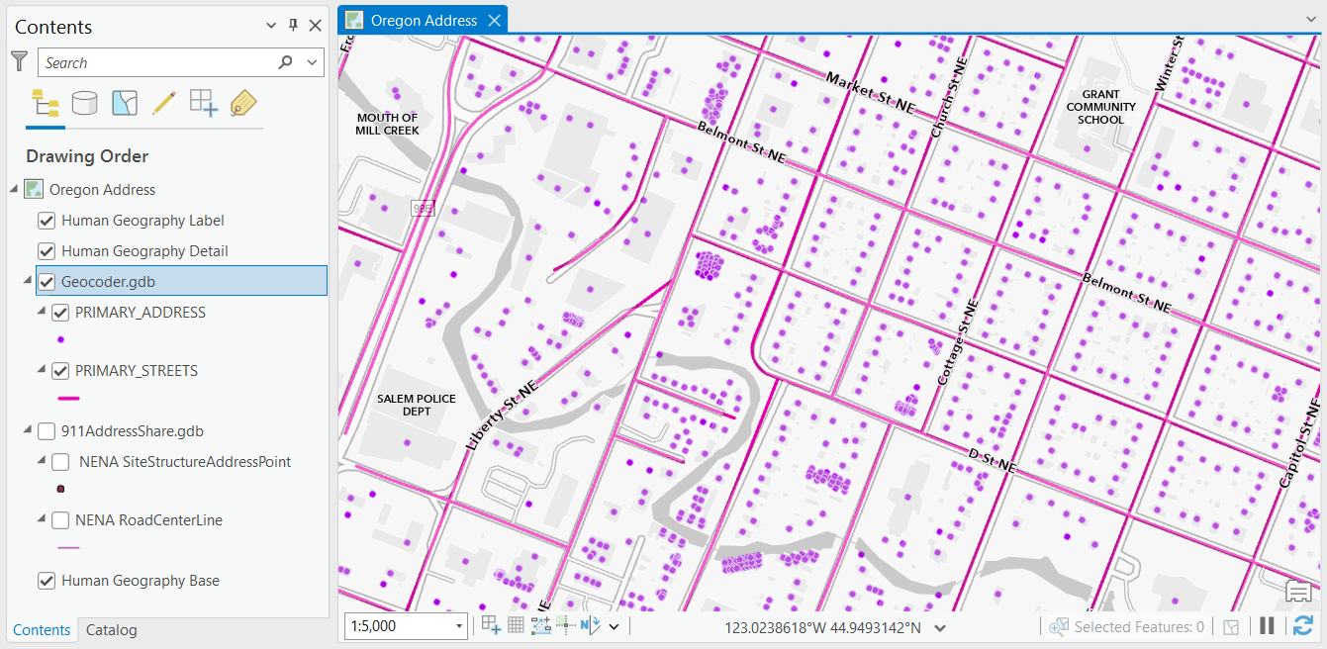
Current Supply Chain – Oregon Address Locator
December 2023
Over Two Million
Address Points
Over 288,000
Street Centerlines

Slide 21
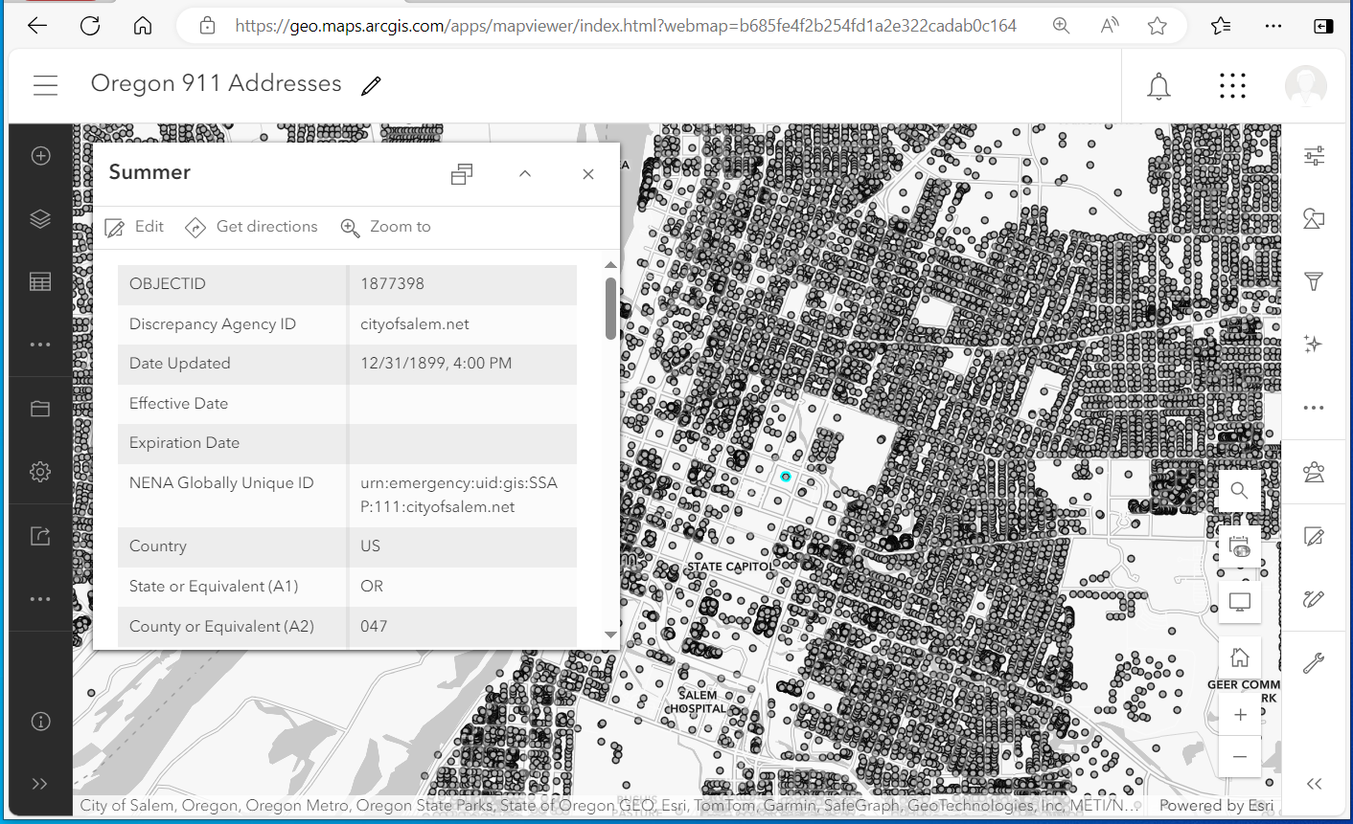
Current Supply Chain – Feature Service
DRAFT Oregon 911 Addresses
https://geo.maps.arcgis.com/home/item.html?id=
2733252edaf44f8e965acdee01f50a89
Not Public – ArcGIS Online group - Login Needed

Slide 22
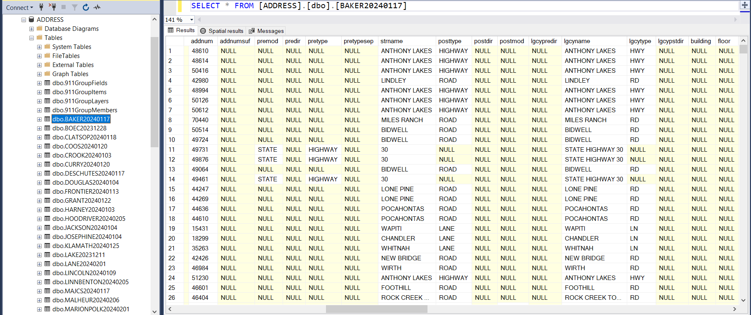
Current Supply Chain – Address Database

Slide 23
Address Standards - National
FGDC Federal Geographic Data Committee
        Current OGIC-Endorsed Standard - 2014
NENA National Emergency Number Association
        NG911 GTAC & PSAPs
NAD National Address Database
USPS US Postal Service
Links for each standard are on the GEOHub Addresses and Buildings Framework page.
Notes:
FGDC current OGIC-endorsed standard (2014)
Numbered Thoroughfare class
FGDC, NENA, NAD
Less familiar
similar in the way they -
Parse street number
Parse street name
Separate city categories
USPS
More familiar
Single street number field
Single street name field
Single city field
OPTIONS
Keep FGDC
Choose another standard
Choose another standard with modified or added fields
Choose none – Completely custom
Combine standards
Combine standards with modified or added fields

Slide 24
Address Standards – All Options
Keep current OGIC-Endorsed FGDC standard
Select another standard
  With additional fields
Select elements from multiple standards
Combine elements from all standards
Create a completely new and unique Oregon standard
Others??

Slide 25
Standards Comparison
FGDC/NENA/NAD are related and very similar
  60% match
    40% match on three fields
    20% match on two fields
FGDC
NENA
OR?
USPS
NAD

Slide 26
Address Standards - Priorities
Identify priorities for the address elements
  Core Most important or mandatory, must be supplied
  Important Recommended, can be derived from core
  Useful Optional or nice to have, can be derived from core or location
  Not important
Additional fields

Slide 27
Workplans
Improve Engagement
Improve Data Governance
Improve Data Accessibility
Improve Data Development

Slide 28
Schedule - 2024
FIT Meetings – TBD Minimum of twice a year
Workgroup Meetings - TBD
Framework Forums – Spring (4/25) and Fall
OGIC Meetings - Quarterly
Deadline

Slide 29
Thank You!
Tom.Elder@das.oregon.gov

