Slide 1
CALIFORNIA HEALTHY PLACES INDEX
Overview of Methods and Results
Excerpts from California Healthy Places Index: Frames Matter
&
California HPI Website
Presented February 8, 2022
Notes:
Over the past few years state agencies have reached out to OHA staff for help with mapping disadvantaged communities.
Several State agencies like ODOT and DLCD are either currently using or are researching tools to target disadvantaged communities for transportation and land use investments. DEQ staff are researching tools to help with environmental mitigation.
We are exploring building an Oregon version of the HPI because it is a tool that uses a science-based approach to identify disadvantaged and resilient communities.
This presentation is not a demo of the California Healthy Places Index. Instead, we will look closely at the underlying methods used to develop the HPI.

Slide 2
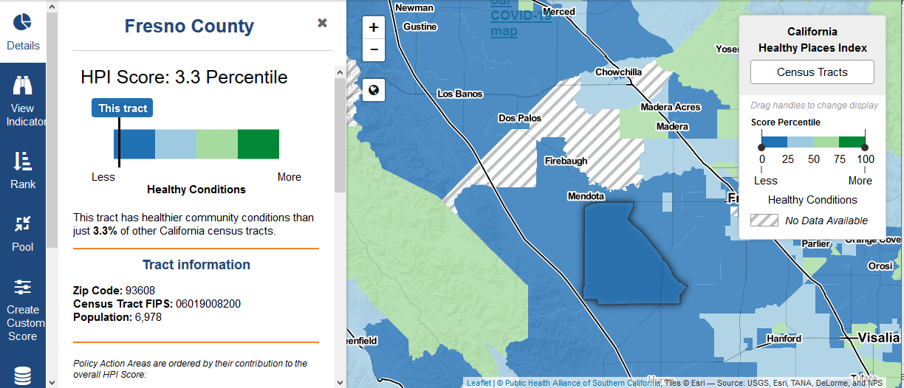
What is the HPI?
Census tract-level mapping tool that can be used to compare and explore community conditions that predict life expectancy
Purpose: prioritize public and private investments, resources and programs
Notes:
Although HPI was developed by a team focused on climate change resilience it is also used to support policies in other areas.
Life expectancy comes from the US Small-area Life Expectancy Estimates Project (LEEP)

Slide 3
HPI Domains and Indicators
HPI is a custom index based on the cumulative impact of user-selected indicators
California HPI combines 25 community indicators from 8 policy action areas into a single indexed HPI Score
Notes:
We will discuss the policy action areas and community indicators in more detail as well as how they were selected.

Slide 4
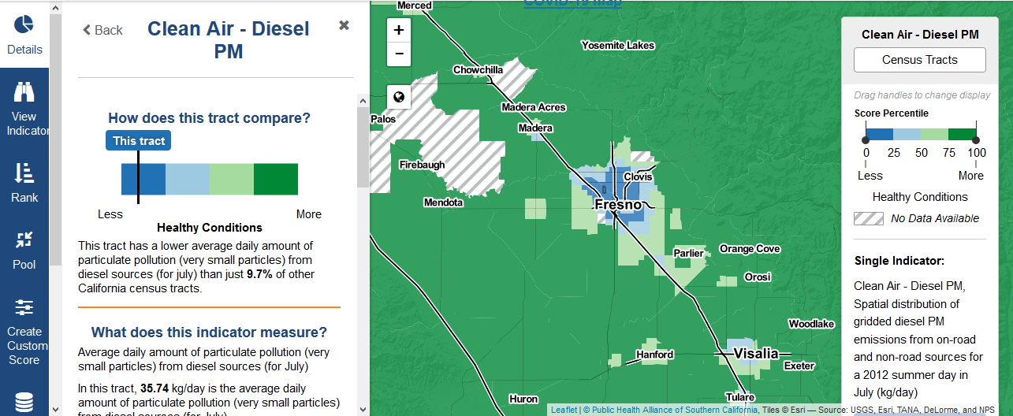
Custom Index
Community indicators inside the 8 policy action areas can be turned off to customize the index.

Slide 5
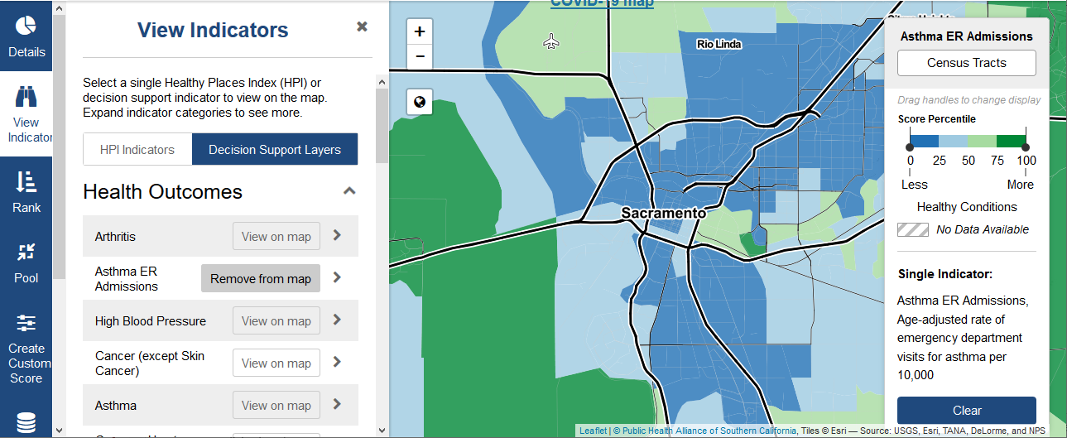
Decision Support Indicators
Many additional decision support layers are also available for custom maps and reports.
Notes:
(discussed on slide 13) Support layers include Air Conditioning Access, Percentage of Children, Crime, Percentage Experiencing Cognitive Disability, Percentage Experiencing Physical Disability, Percentage Elderly, Extreme Heat Days, Impervious Surfaces, Outdoor Workers, Public Transit Access and Sea Level Rise. The tool also includes links to other index tools: CalEnviroScreen and the Hardship Index
Virginia Commonwealth University was added to the team to help improve the first version of the HPI

Slide 6
Index Construction
8 policy action areas (domains) were selected
Policy action area indicators were selected from literature reviews
Indicators must meet 7 criteria:
free and publicly available data
statewide census tract coverage (2010 pop ≥1500 & <50% in group quarters)
actionable
timely and current data
statistical association with life expectancy at birth
minimized collinearity
compatibility with allied public health and other governmental agency projects
Health outcomes are excluded to avoid autocorrelation
Notes:
I think you’ll see as we go through the slides, we have a lot of flexibility in selecting indicators based on the needs of our stakeholders and deciding how to weight the indicators
Wheeler County had 1,450 people in 2020

Slide 7
Action Areas and Indicators
Notes:
This graphic shows the eight Policy Action Areas, their weights within the index, and the 25 Community Characteristics that are combined into the overall HPI score.
*Note: The “income” community characteristic in the Economic Policy Action Area includes two indicators: “above poverty” (% of population with an income exceeding 200% of Federal poverty level) and “income” (median household income).
The 8 domains are:
Economics
Education
Healthcare access
Housing
Neighborhood conditions
Clean environment
Social environment
Transportation

Slide 8
Indicator Exclusions
37 indicators were initially selected and assigned to a domain
Each indicator was assessed for its adherence to the 7 criteria listed in the previous slide
Several indicators were excluded that had paradoxical associations with life expectancy at birth
Notes:
Multicollinearity was assessed for each of the domains by calculating a within-domain variance inflation factor (VIF) for each candidate indicator.
A VIF of 4 or greater was used as a criteria for identifying excessive multi-collinearity among domain indicators
The variance inflation factor provides an index that measures how much the variance (the square of the estimate's standard deviation) of an estimated regression coefficient is increased because of collinearity.

Slide 9
Action Areas and Indicators
Notes:
LEB = Life Expectancy at Birth
HDC = Housing Development Corporation or possible typo and California Housing and Community Development
Housing cost burden includes rent, utilities, and fuel costs for renters. They include mortgage or purchase contract payments, utilities, fuel costs, taxes, and insurance for homeowners
Housing cost burden was redefined to focus on low-income populations and a higher level of burden (50% vs. 30% of income) in order to be consistent with definitions from the California Department of Housing and Development.

Slide 10
Action Areas and Indicators

Slide 11
Domain Weights and Total Score
Domains weighted by strength of association with life expectancy at birth
Domain value = arithmetic mean of indicator z-scores
Indicators
Standardized by z-scores
Notes:
Indicator Standardization and Scaling
Each indicator was standardized by computing its Z-score, which is aligned so that higher values indicated greater advantage. This required "flipping" scores (multiplying by -1 or subtracting from 100%) for Clean Environment variables and severe housing cost burden indicators, which were framed in the negative direction: higher values indicate less advantage.
Domain Weighting
Domain weights were empirically estimated using a weighted and constrained least squares regression model of the eight domain scores against LEB.
HPI = (w1 * 𝑍̅ Economic) + (w2 * 𝑍̅Education) + (w3 * 𝑍̅ HealthcareAccess) + (w4 * 𝑍̅Housing) + (w5 * 𝑍̅ Neighborhoods) + (w6 * 𝑍̅ Clean Environment) + (w7 * 𝑍̅ Social) + (w8 * 𝑍̅ Transportation)
Domains are allotted more weight if they contribute more to the prediction of LEB.
All Domains are guaranteed a minimum 5% weight. Because all domains and indicators were carefully chosen based on expert opinion and evidence for an association with health in the literature, the developers wanted to ensure that each domain retained a minimum weight. A minimum weight of 5% leaves 60% of the weighting to the modeling process (8 domains ´5% = 40% will be in the model based on this criteria).
If a modeled domain weight were much larger than expected based on expectations from the literature and prior experience with an index like this, the developers would consider instituting an upper bound with the advice and consent of the Steering Committee. (This contingency did not occur.) Missing data were excluded in the initial calculation of domain weights. For comparison in a subsequent sensitivity analysis, domain weights were also calculated using imputed values for missing data.
Multicollinearity was assessed for each of the domains by calculating a within-domain variance inflation factor (VIF) for each candidate indicator.
A VIF of 4 or greater was used as a criterion for identifying excessive multi-collinearity among domain indicators
The variance inflation factor provides an index that measures how much the variance (the square of the estimate's standard deviation) of an estimated regression coefficient is increased because of collinearity.

Slide 12
Domain Weights and Total Score
Domain average Z-score
HPI Score (percentiles)
SUM
Domain weight
Notes:
Domain Weighting
Domain weights were empirically estimated using a weighted and constrained least squares regression model of the eight domain scores against LEB.
HPI = (w1 * 𝑍̅ Economic) + (w2 * 𝑍̅Education) + (w3 * 𝑍̅ HealthcareAccess) + (w4 * 𝑍̅Housing) + (w5 * 𝑍̅ Neighborhoods) + (w6 * 𝑍̅ Clean Environment) + (w7 * 𝑍̅ Social) + (w8 * 𝑍̅ Transportation)
Domains are allotted more weight if they contribute more to the prediction of LEB.

Slide 13
Results
Economic resources and education accounted for 50% of the domain weights
Healthcare access, housing, and pollution/clean air environment correlated weakly with life expectancy at birth and received the 5% minimum weight.
The racial residential integration domain had a weight of 0.13 when treated as a separate domain (previous version of HPI)
The total HPI score was strongly associated with life expectancy at birth (r = 0.53) and had an R² of 0.31 in simple linear regression
Notes:
All Domains are guaranteed a minimum 5% weight. Because all domains and indicators were carefully chosen based on expert opinion and evidence for an association with health in the literature, the developers wanted to ensure that each domain retained a minimum weight. A minimum weight of 5% leaves 60% of the weighting to the modeling process (8 domains ´5% = 40% will be in the model based on this criteria).
If a modeled domain weight were much larger than expected based on expectations from the literature and prior experience with an index like this, the developers would consider instituting an upper bound with the advice and consent of the Steering Committee. (This contingency did not occur.) Missing data were excluded in the initial calculation of domain weights. For comparison in a subsequent sensitivity analysis, domain weights were also calculated using imputed values for missing data.
The race/ethnicity version of HPI included a domain whose single indicator was the index of dissimilarity (IOD) referenced by the county percentage of Black residents.
The race/ethnicity domain weight was 0.13 and other 8 domains experienced small reductions in their original weights. The HPI with race had a slightly higher correlation with LEB (r=0.58)
and variance explained (R2 = 0.33) compared to version without race.

Slide 14
Decision Support Indicators & Domains
Race
California’s Prop 209 prohibits allocating certain kinds of public resources based on race and ethnicity
Earlier HPI version includes a race/ethnicity domain (index of dissimilarity)
Health Behaviors and Outcomes
Health behaviors and outcomes can be analyzed in conjunction with core neighborhood conditions and factors that influence them
Most health outcomes are from CDC 500 Cities data (now PLACES)
Climate Change and Health Vulnerability Indicators
Some climate risks and vulnerabilities did not meet the criteria for inclusion in the HPI score itself including air conditioning access, percentage of children, crime, disabilities, percentage elderly, extreme heat days, impervious surfaces, outdoor workers, public transit access and sea level rise
Notes:
Notes might not be necessary
Economic resources did not end up getting the full weight
Minimum threshold diminished weights of other domains
Racial residential integration would change the weight distribution
Low correlations with healthcare access, housing and clean air environments are likely responsible for the low R2 value.
Extensive scientific research was conducted to identify indicators that are associated with life expectancy, are related to climate change and are actionable.
Health Outcomes – Life expectancy is a catch-all for health outcomes and is not included in the index. Inclusion of life expectancy at birth or other health outcomes as an explicit part of the index would create circular reasoning and blur the distinction between health promoting community conditions (SDOH inputs) from expected health outcomes (output).
Race/Ethnicity - Despite the important role these factors play in shaping health, California’s Prop 209 prohibits allocating certain kinds of public resources based on race and ethnicity. In order to ensure the Healthy Places Index can be used in a variety of applications, including informing policy decisions, the Alliance has made additional, informational layers about Race/Ethnicity available on our online map.

Slide 15
Decision Support Indicators & Domains
Domain | Indicator Examples | Exclusion
Health outcomes | Heart disease Asthma | Confound with life expectancy at birth
Climate threat | Extreme heat days Wildfire risk Sea level rise | Strategies for resilience are built into the HPI
Built environment and climate resilience | Air conditioning Traffic density | Geographic coverage Contrary association with LEB
Social and climate vulnerability | Children under 5 Foreign born | Other similar indicators Difficult to message
Other indices of disadvantage | Hardship Index | Includes HPI indicators

Slide 16
HPI vs. CalEnviroScreen
Of census tracts in the most disadvantaged quartile based on the HPI, 649 tracts (representing 3 million people) fell outside of the most disadvantaged quartile as determined by the CalEnviroScreen
CalEnviroScreen failed to detect one-third of census tracts with the worst conditions for population health.
Differences in approach have substantial consequences for millions of persons, neighborhoods, and communities that are either selected or passed over for potential investments.
This discordance occurred despite substantial overlap in indicators and domains.
Notes:
How a tool that tracks California’s ‘disadvantaged communities’ is costing S.F. millions in state funding
CalEnviroScreen includes 2 domains: exposure potential and vulnerability
Additional resource: https://empowerla.org/wp-content/uploads/2020/08/Sadler_HPI-Presentation-to-LA-NB-Commn-8-17-2020.pdf

Slide 17
HPI Uses
Integrating HPI Into Your Plans And Assessments
Generating Reports
Capacity Building
Policy Actions
Grant Application Technical Assistance
Notes:
General Plans: using HPI to identify health, equity, and environmental justice issues that need to be addressed in a General Plan element, including requirements of SB 1000 pertaining to environmental justice, and creating and/or integrating health and equity elements into the general plan.
Other Types of Plans: using HPI to identify health, equity, and environmental justice issues in another type of plan at the site-specific, community or regional level, including land use, transportation, housing, climate, water, food, etc.
Community Health Assessments (CHAs) and Community Health Needs Assessments (CHNAs): using the data and information in HPI as part of the assessment processes undertaken by public health departments and hospitals, separately or jointly.
Health Department Accreditation: using HPI to develop a health equity plan that meets the requirements of the State’s Public Health Department Accreditation process
Program Assessment: using HPI to build health equity into the evaluation/assessment of programs in any sector.
Place-Based Equity Assessments: using HPI to identify equity issues within a community

Slide 18
https://healthyplacesindex.org/policy-actions/
Notes:
There 30 extensive guides available across the 8 policy action areas. The guides are available directly from the HPI tool.
The California HPI website offers many examples that demonstrate how the HPI can be used to affect policy.
The links include:
connection to health
how to get started
policy Opportunities to Address the health impacts of indicators

Slide 19
Next Steps
Build partnerships with interested agencies
Work with partners to evaluate data that fit within policy action areas
Build new Oregon specific Life Expectancy at Birth data (PSU Population Research Center)
Build an Oregon HPI data repository (DAS-GEO).
Governor Brown submitted a bill to the 2022 legislature, House Bill 4077, that is getting it’s first hearing tomorrow and would direct a state Environmental Justice Council to oversee development by OHA and DEQ of an environmental justice mapping tool in consultation with communities and in collaboration with DAS-GEO and Oregon State University.
Notes:
General Plans: using HPI to identify health, equity, and environmental justice issues that need to be addressed in a General Plan element, including requirements of SB 1000 pertaining to environmental justice, and creating and/or integrating health and equity elements into the general plan.
Other Types of Plans: using HPI to identify health, equity, and environmental justice issues in another type of plan at the site-specific, community or regional level, including land use, transportation, housing, climate, water, food, etc.
Community Health Assessments (CHAs) and Community Health Needs Assessments (CHNAs): using the data and information in HPI as part of the assessment processes undertaken by public health departments and hospitals, separately or jointly.
Health Department Accreditation: using HPI to develop a health equity plan that meets the requirements of the State’s Public Health Department Accreditation process
Program Assessment: using HPI to build health equity into the evaluation/assessment of programs in any sector.
Place-Based Equity Assessments: using HPI to identify equity issues within a community

Slide 20
Questions?
Eric Main
Public Health Division
Environmental Public Health
eric.c.main@state.or.us
The California HPI was developed by the Public Health Alliance of Southern California (Alliance) in partnership with the Virginia Commonwealth University’s Center on Society and Health
Citations:
California HPI website: https://healthyplacesindex.org/
Delaney T, Dominie W, Dowling H, Maizlish M. Healthy Places Index(HPI 2.0). Feb 20, 2018 (revised Apr 22, 2021). Downloaded from https://healthyplacesindex.org/ on Jul 16, 2021.
Maizlish N, Delaney T, Dowling H, Chapman DA, Sabo R, Woolf S, Orndahl C, Hill L, Snellings L. California Healthy Places Index: Frames Matter. Public Health Rep. 2019 Jul/Aug;134(4):354-362. doi: 10.1177/0033354919849882. Epub 2019 May 16. PMID: 31095451; PMCID: PMC6598140.

