Slide 1
Matt Williams, FIT Co-lead
February 25, 2025
Oregon Framework
16 themes that form the foundation for an authoritative seamless statewide GIS

Slide 2
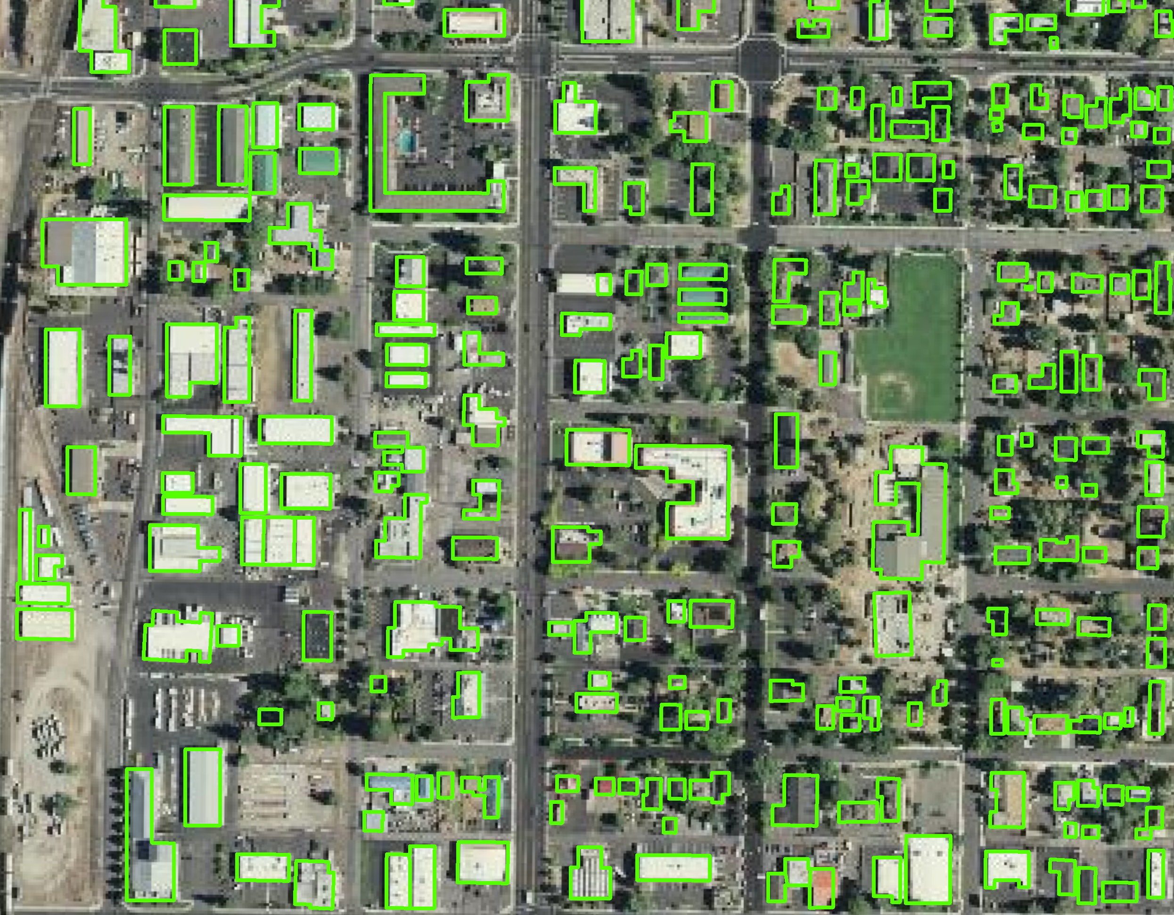
Presentation Overview
Attribute categories
  Structure
  Address
  Parcel
  Metadata
Review of proposed attributes
Consensus building discussion

Slide 3
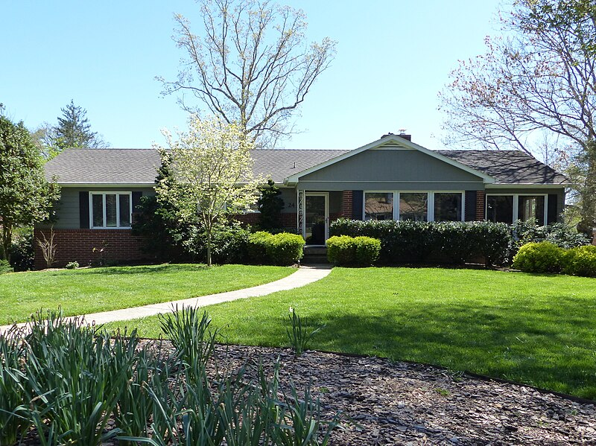
Attribute: ORBLD_ID
FIELD NAME: ORBLD_ID
DESCRIPTION: Unique identifer
FORMAT: 05-1234567
DATA TYPE: text
CHAR LENGTH: 10
NULL VALUES: No
Domain: No

Slide 4
Attribute: COUNTY
FIELD NAME: COUNTY
DESCRIPTION: County name
FORMAT: Clackamas or Hood River
DATA TYPE: text
CHAR LENGTH: 10
NULL VALUES: No
DOMAIN: Yes

Slide 5
Attribute: FLOATING STRUCTURE
FIELD NAME: FLOATING_STRUCTURE
DESCRIPTION: Structure is on water
FORMAT: 0 or 1
DATA TYPE: Short Int
CHAR LENGTH: 1
NULL VALUES: No
DOMAIN: Yes

Slide 6
Attribute: FLOATING STRUCTURE
FIELD NAME: FLOATING_STRUCTURE
DESCRIPTION: Structure is on water
FORMAT: 0 or 1
DATA TYPE: Short Int
CHAR LENGTH: 1
NULL VALUES: No
DOMAIN: Yes

Slide 7
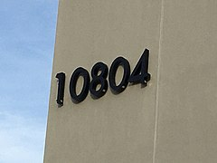
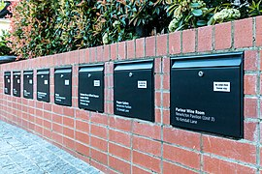

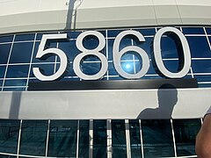
Attributes: ADDRESS
Address_ID
Address
Num_Units (redundant with Housing Units?)
Bld_Name *
Historic (yes or no)

Slide 8
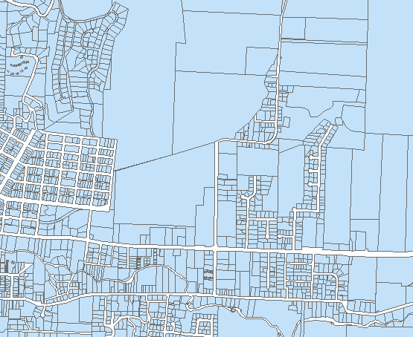
Attributes: PARCEL
Parcel_ID
Parcel_Num
Basement (yes or no)
Housing_Unit * (redundant with Number of Units?)
Num_Stories
YEAR_BUILT
Year_Src *
First_Flr_Ht
Bld_Type
Found_Type
Occ_Type
ReplacementCost*
RMV *
RMV_Src *

Slide 9
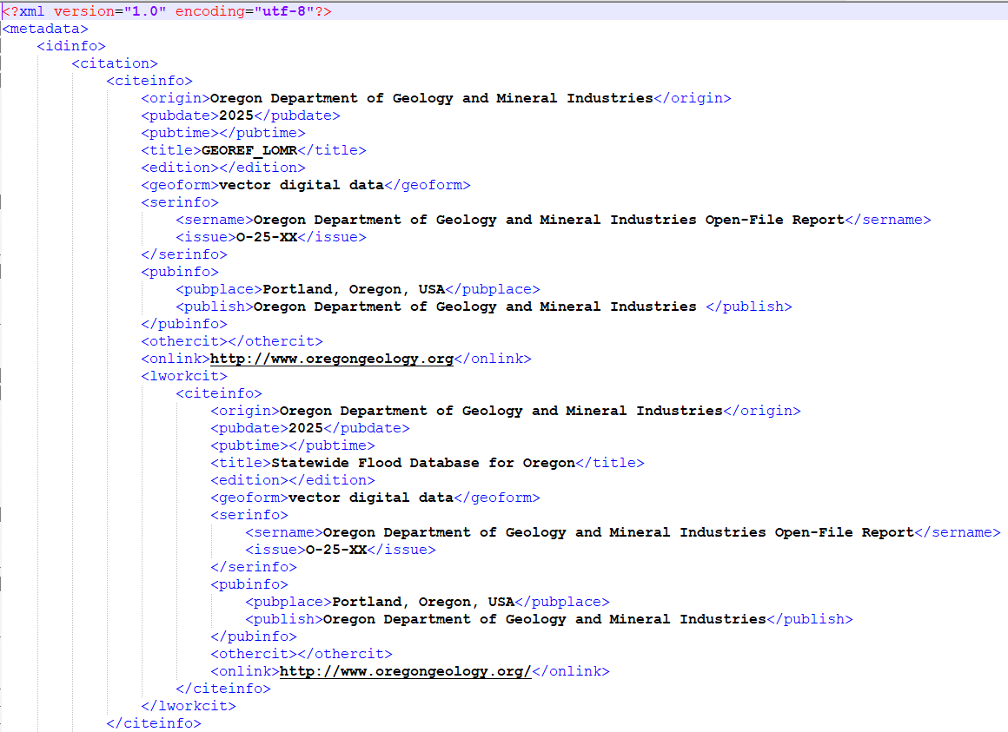
Attributes: METADATA
PUB_DATE
REVIEW_DATE
REVIEW_IMG
REVIEW_IMG_YEAR
BLD_SRC (currently “SOURCE”)
BLD_SRC_DATE (currently “SOURCE_DATE”)
BLD_SRC_TYPE (currently “SOURCE_TYPE”)
CONTRIBUTOR
Editor *

Slide 10
Review: STRUCTURE
Latitude & Longitude*
Flood_zone *
Float_struc
LAG
ROOF_MAX *
ROOF_MEAN
Roof_Type *
URM *
COUNTY *
Zipcode *

Slide 11
Review: ADDRESS
Address_ID
Address
Num_Units (Housing Units) *
Bld_Name *
Historic

Slide 12
Review: PARCEL
Parcel_ID
Parcel_Num
Basement
Housing_Unit *
Num_Stories
YEAR_BUILT
Year_Src
First_Flr_Ht
Bld_Type
Found_Type
Occ_Type
RMV *
RMV_Src *

Slide 13
Review: METADATA
PUB_DATE
REVIEW_DATE
REVIEW_IMG
REVIEW_IMG_YEAR
BLD_SRC
BLD_SRC_DATE
BLD_SRC_TYPE
CONTRIBUTOR
Editor *

Slide 14

Next steps
Consensus attributes
Attribute format discussion
“Proto Data Standard”
Identify any lingering issues
Image source: Wikimedia commons, Jamidwyer, 11/9/2006

Slide 15
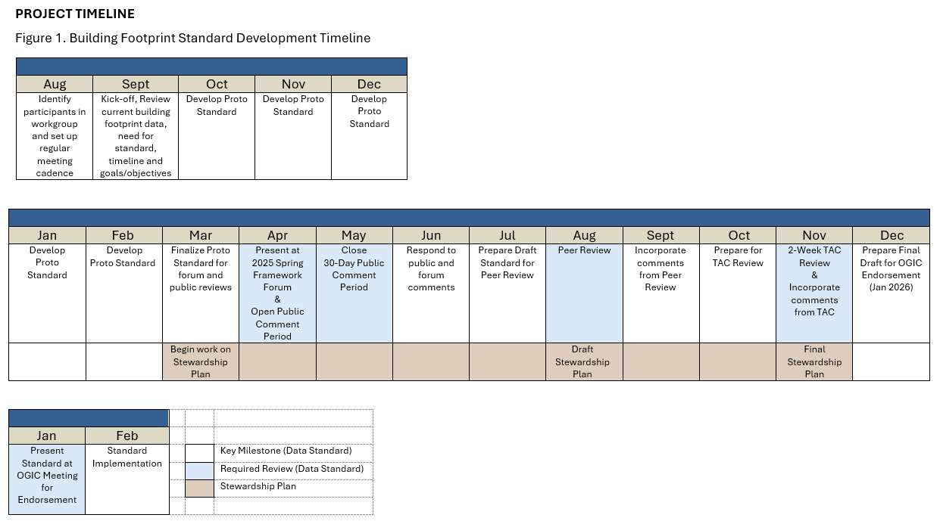
Possible Future Updates

Slide 16
Thank You!
Tom.Elder@das.oregon.gov
Matt.Williams@dgmi.oregon.gov

